Slide 1
Developing Strategies for Cultural Districts in BIA Neighbourhoods
OBIAA Conference 2024
Notes:
(M)

Slide 2


Welcome to Mississauga!
Culture Planning & Public Art
We support the growth of the culture sector by informing and developing strategies and policies
Advocate for cultural infrastructure
Conduct strategic planning for culture across the City
Provide free and equal access to high quality arts experiences by commissioning professional artists to create artwork for public spaces
We leverage public and private funding and site opportunities
Michael Tunney
Manager, Culture Planning and Public Art
City of Mississauga
Zainab Abbasi
Planner, Culture
City of Mississauga
Notes:
(M)
Welcome to Mississauga!
(Introduce ourselves)
Here’s a little bit about what we do: Culture Planning & Public Art
We support the growth of the culture sector by informing and developing strategies and policies
We review plans, policies, and studies to advocate for cultural infrastructure
Conduct strategic planning for culture across the City
We provide free and equal access to high quality arts experiences by commissioning professional artists to create artwork for public spaces
We leverage public and private funding and site opportunities

Slide 3
Land Acknowledgement
We acknowledge the lands which constitute the present-day City of Mississauga as being part of the Treaty and Traditional Territory of the Mississaugas of the Credit First Nation, The Haudenosaunee Confederacy, and The Huron-Wendat and Wyandot Nations. We recognize these peoples and their ancestors as peoples who inhabited these lands since time immemorial. The City of Mississauga is home to many global Indigenous peoples.
Notes:
(M)
We acknowledge the lands which constitute the present-day City of Mississauga as being part of the Treaty and Traditional Territory of the Mississaugas of the Credit First Nation, The Haudenosaunee Confederacy, and The Huron-Wendat and Wyandot Nations. We recognize these peoples and their ancestors as peoples who inhabited these lands since time immemorial. The City of Mississauga is home to many global Indigenous peoples.

Slide 4
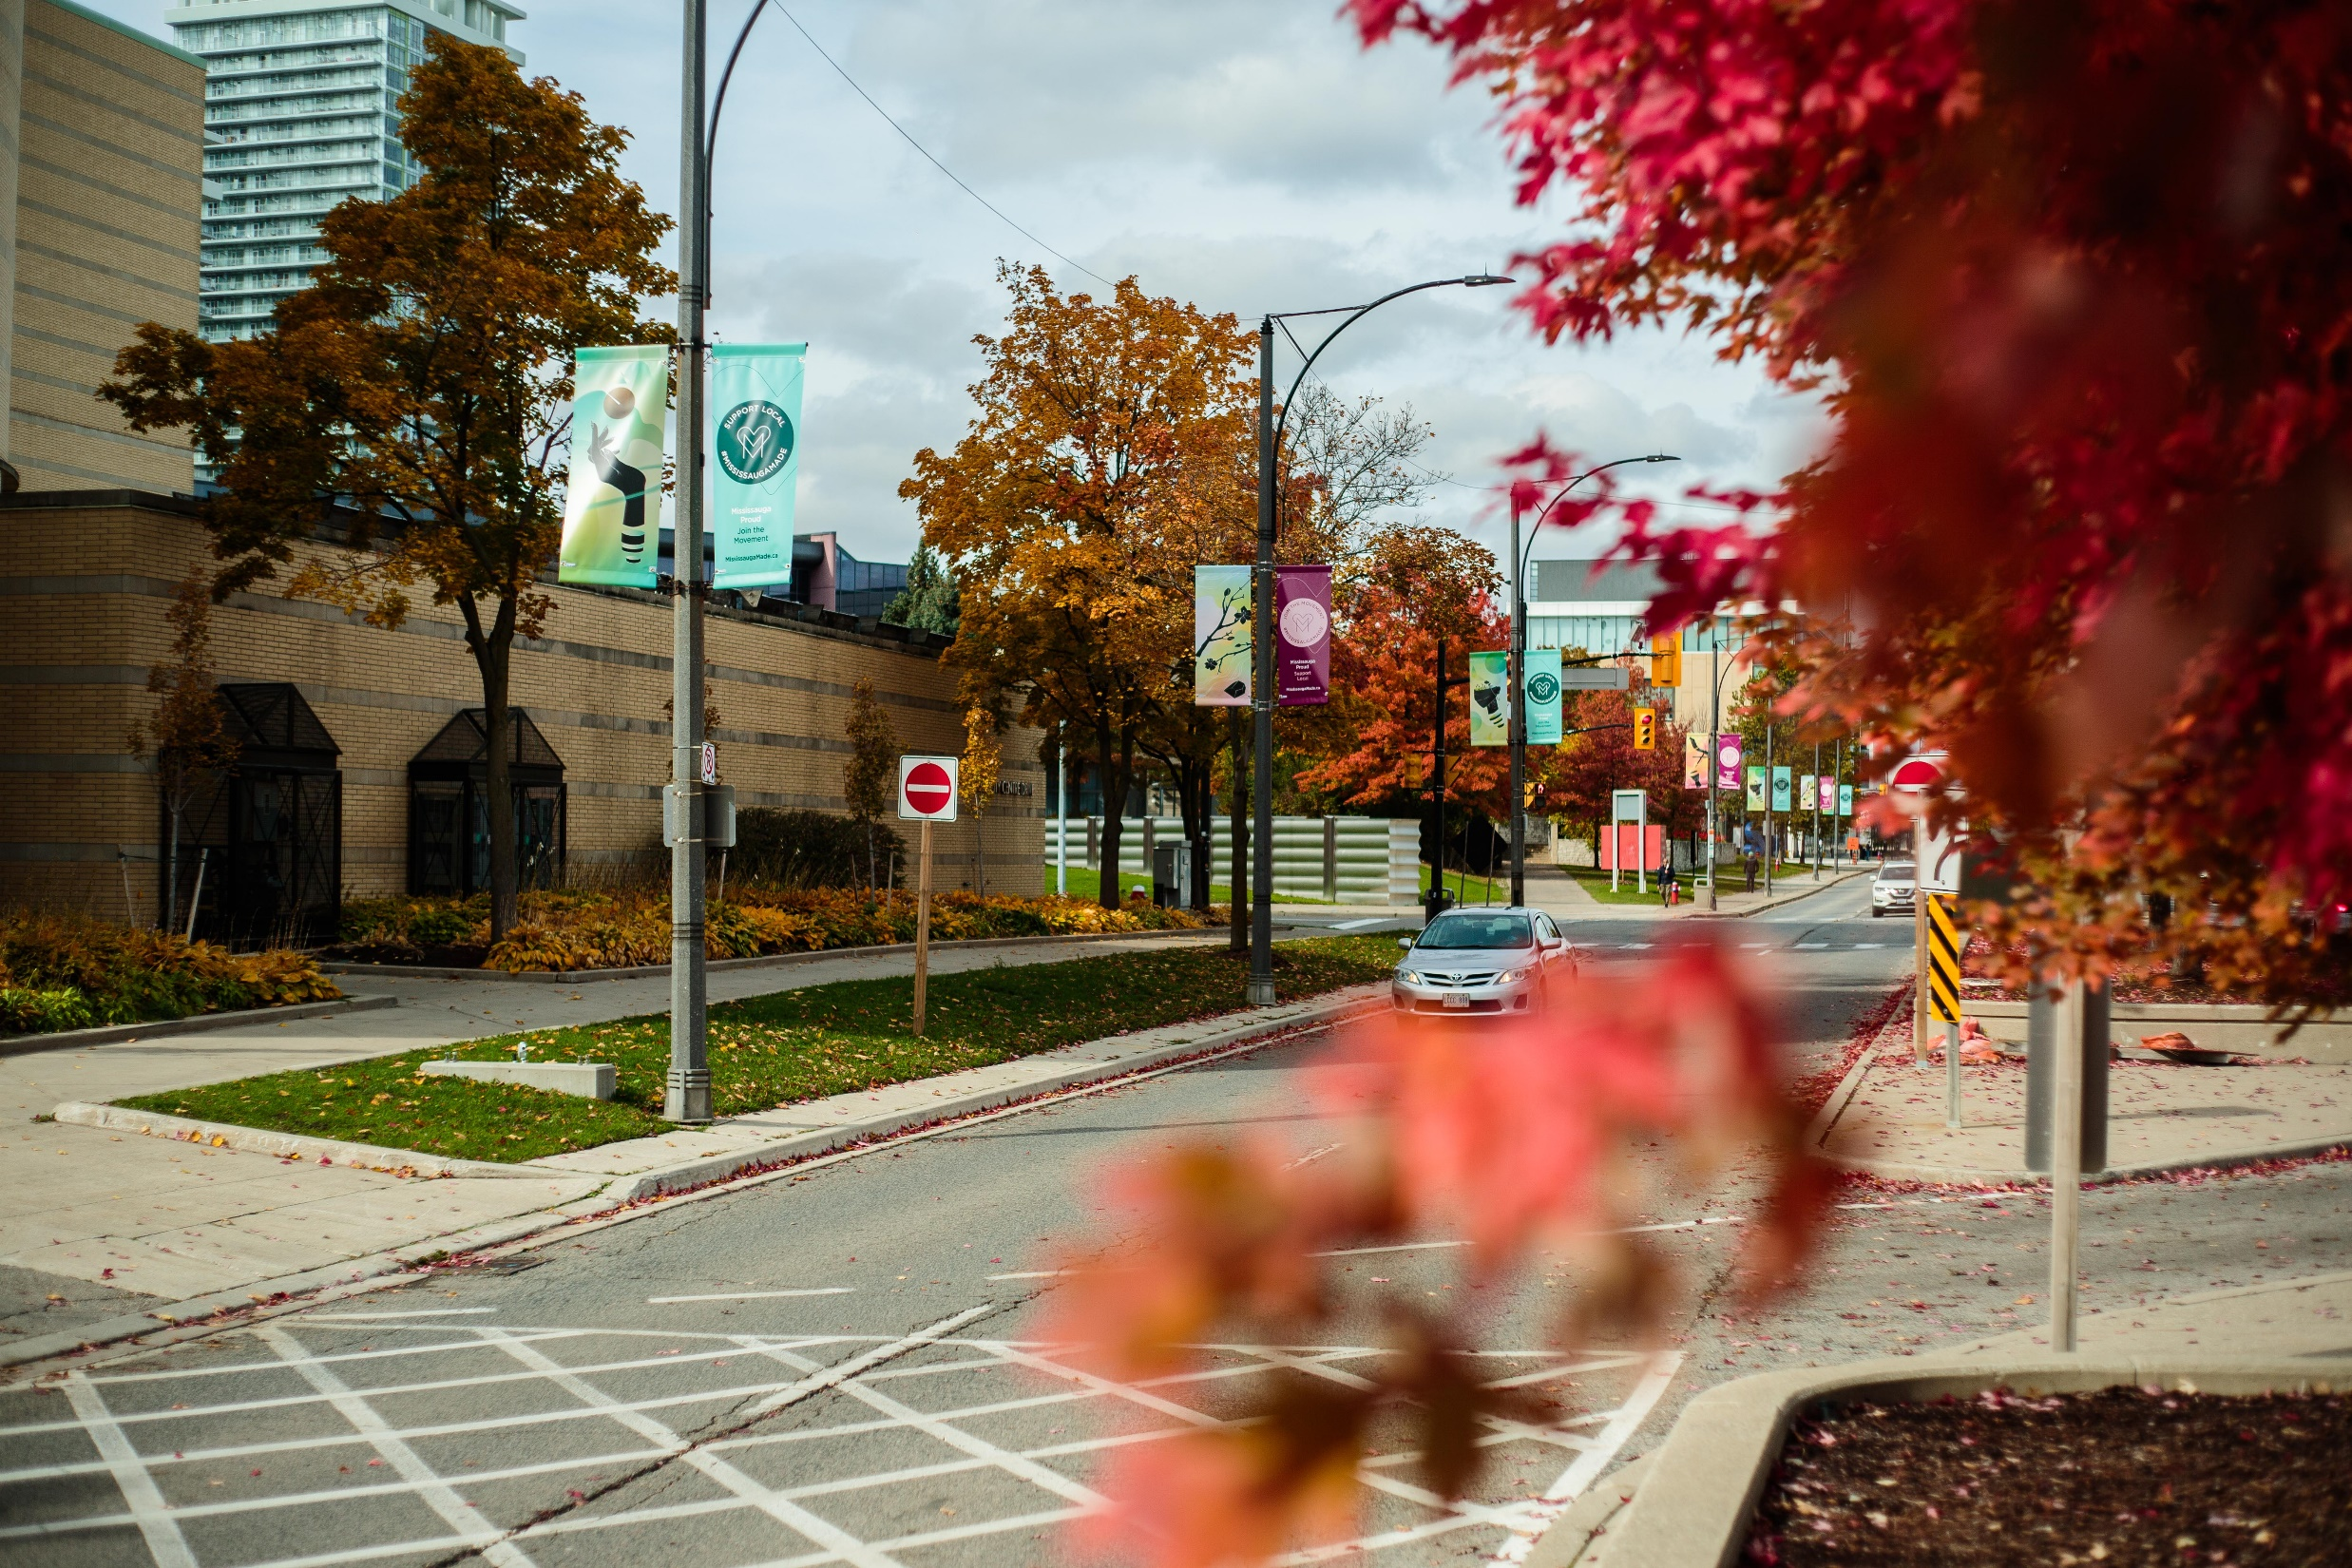
Cultural Districts
Notes:
(Z)
Today’s presentation we’ll tell you all about the Cultural Districts, our Placemaking Projects and how we work with the BIAs, we’ve also created opportunities for discussion throughout the session because we’d love to hear from you

Slide 5
Cultural Districts
Cultural districts are well-recognized, labeled areas of a city with a high concentration of cultural facilities and programs that serve as the main anchor of attraction.
Notes:
(Z)
What are Cultural Districts?
Cultural districts are well-recognized, labeled areas of a city with a high concentration of cultural facilities and programs that serve as the main anchor of attraction.
The purpose of establishing cultural districts in Mississauga has been to:
To enhance and improve culture spaces and places in the City of Mississauga by focusing cultural development, public realm enhancements and cultural programming in distinct cultural districts.

Slide 6
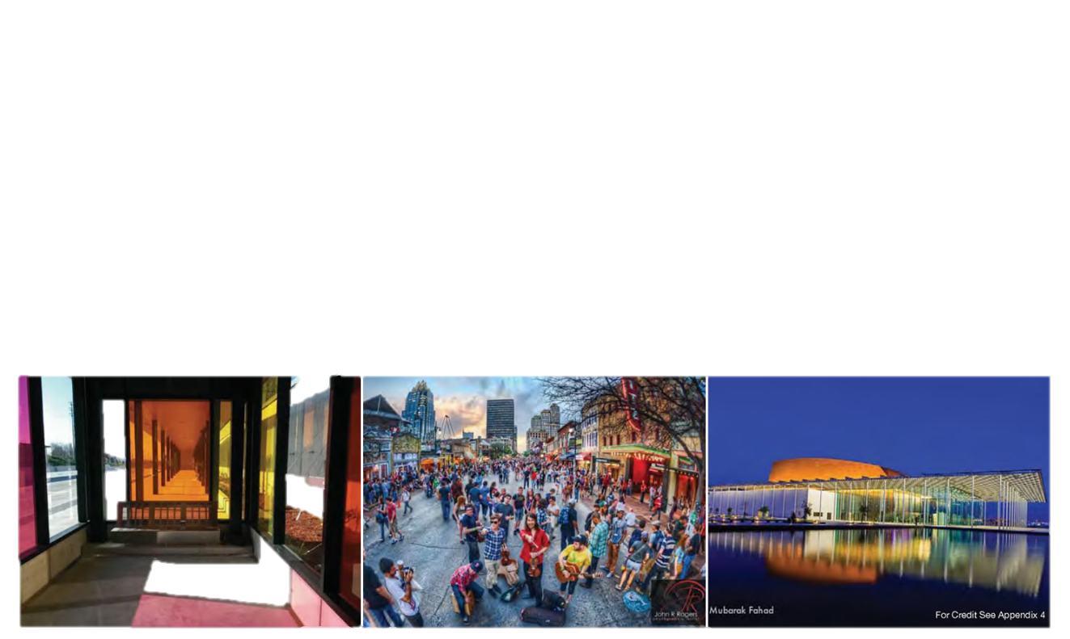
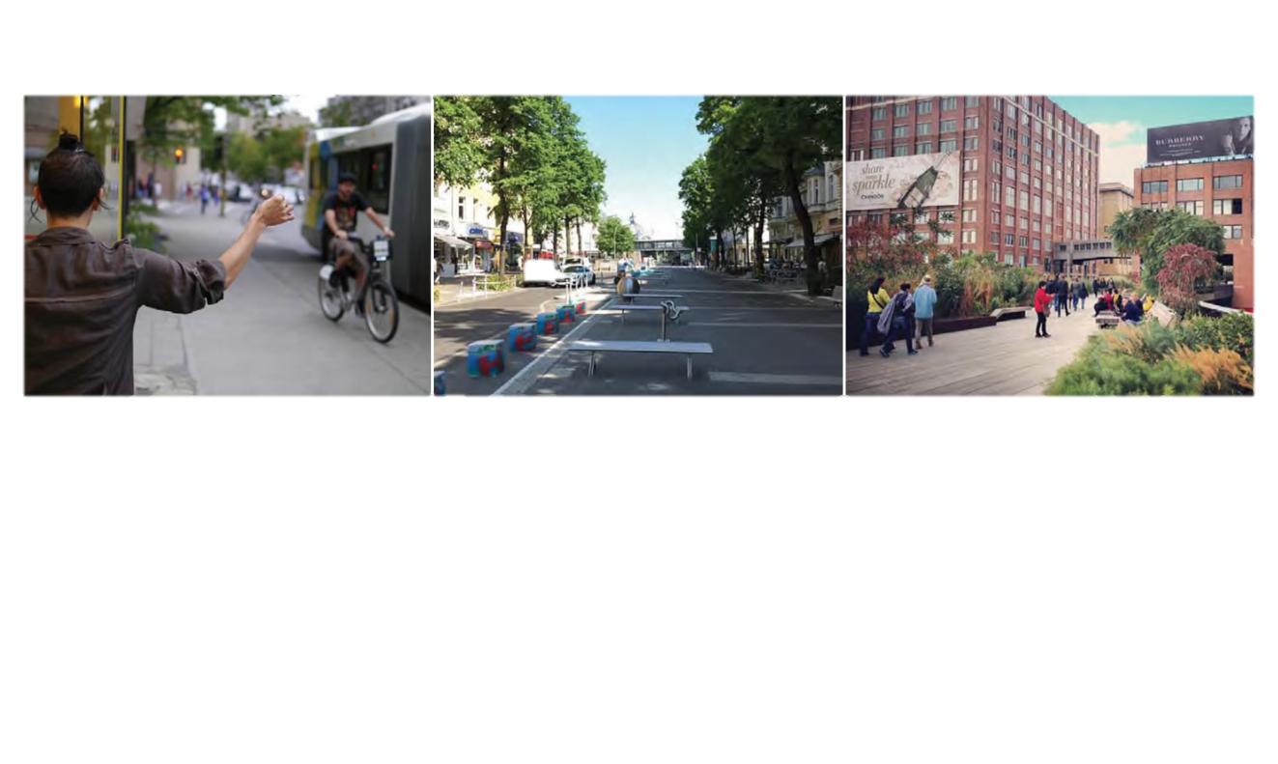
Close proximity to transit
Mix of Land Uses
Inviting Parks and Public Spaces
Artful public realm
Vibrant walkable streets
Arts and entertainment facilities
Notes:
(Z)
Here are some of the key characteristics of cultural districts, based on examples from around the world. We used these characteristics to identify potential districts in Mississauga.

Slide 7
A dedicated and willing partner - BIAs
A strong, on the ground partner that is actively involved in the community and working to enhance the neighbourhood main street areas
Local cultural and community organizations
Notes:
(Z)
In addition to those characteristics, having a strong, on the ground partner has also been crucial to the cultural districts --- this is where the BIA comes in
We looked for neighbourhoods that had an existing BIA that was actively involved in the community and working to enhance the neighbourhood main street areas

Slide 8
Where we started
2009 Culture Master Plan
Port Credit Culture Node (2011 – 2017)
2019 Culture Master Plan
Cultural Districts Implementation 2021 – 2024
2024 Culture Plan
Notes:
(M)
Now we’ll backtrack to how we came to establishing the Cultural Districts.
In 2009, we established our first Culture Master Plan which set out the vision for culture in Mississauga
In 2014, we led a pilot project in Port Credit – the Culture Node – which began testing some of the activations and policies on a temporary basis and was really the precursor to the Cultural Districts

Slide 9
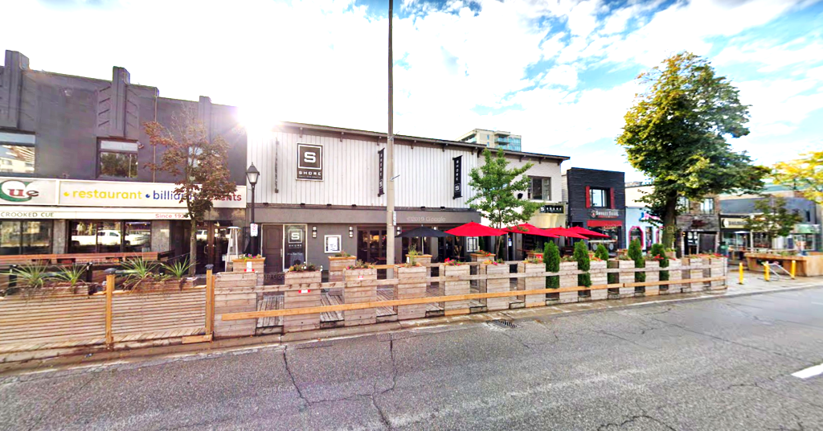
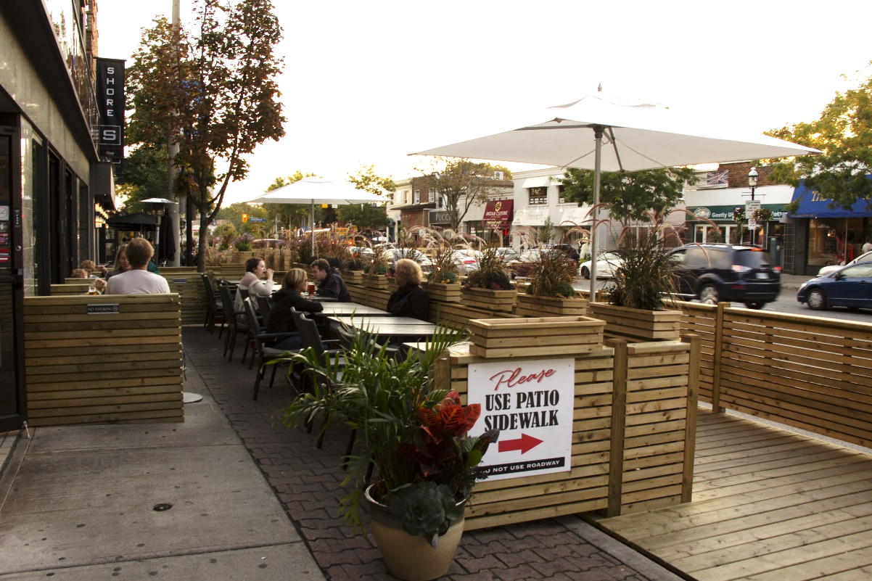
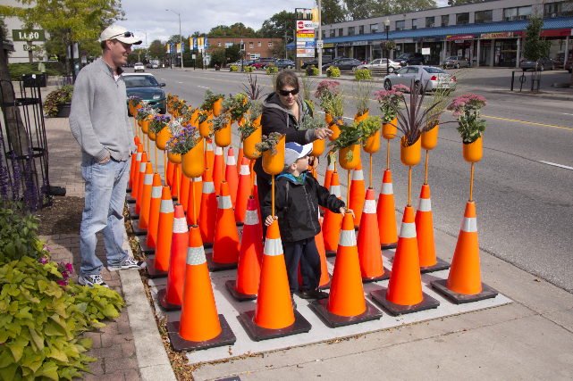
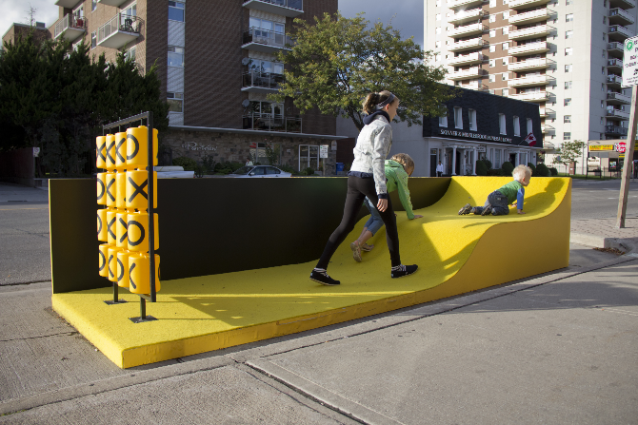
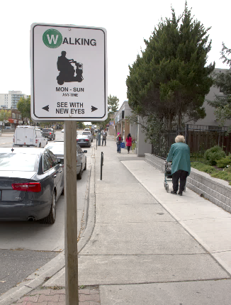
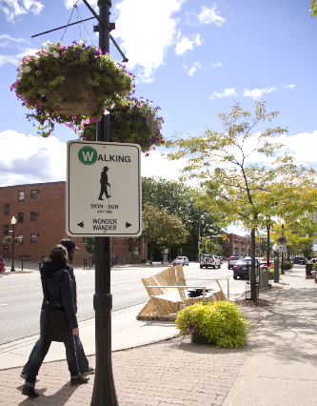
Port Credit Culture Node Pilot
Notes:
(M)
Port Credit Culture Node Pilot
Through the Port Credit Culture Node we tested temporary outdoor patios in the right of way – that businesses could apply for – with fees exempted for a pilot project period of time
We also did other interactive art installations in parking lots as part of PARK-ing Day
Outdoor music was also permitted on the patios
This was really the starting point for us in terms of implementing supportive measures to increase pedestrian activity, encourage more people to linger and explore
Specific mechanisms used to permit the outdoor patios:
Initially it was a minor variance through the CoA to permit patios in the public ROW within the PC Area (the BIA boundary) – for a 5 year term from 2012
Only areas zoned for commercial purposes could participate in the program
Businesses applied and entered into an encroachment agreement with the City – had to continue to provide unencumbered pedestrian walkway (this is where you see the add one of these temporary wooden walkways)
The program was seasonal (April 15 – Oct 15)
Through other minor variances, the program was extended and expanded
The encroachment application fee and legal fee were waived for the temporary period of time (about $900)
Also since it included the removal of parking spots to accommodate the walkways, there was revenue loss
In 2018, there was a 3 year renewal of the temporary use by-law – up to 2022 and in the meantime the City would find a permanent solution for the temporary uses
During the pandemic, the City implemented temporary use zoning by-laws – fees waived, requirements on public and private lands – this was a huge support for local businesses during the pandemic to offer safe outdoor dining

Slide 10
Port Credit Culture Node Pilot
Patios, art installations & retail sales in right-of-way
Live acoustic music on outdoor patios
Extended business hours
Increased foot traffic
Increased retail sales & added jobs
Economic growth
Animated the public realm
Notes:
(M)
This was really the starting point for us in terms of implementing supportive measures to increase pedestrian activity, encourage more people to linger and explore
In the survey
10% reported an increase in foot traffic and sales as a result of participation. They also hired additional staff and expanded hours of operation.
42% increase in foot traffic and sales also for those that didn’t participate
87% of businesses (26 businesses) supported continuation of the project
Overall a lot of positive support

Slide 11
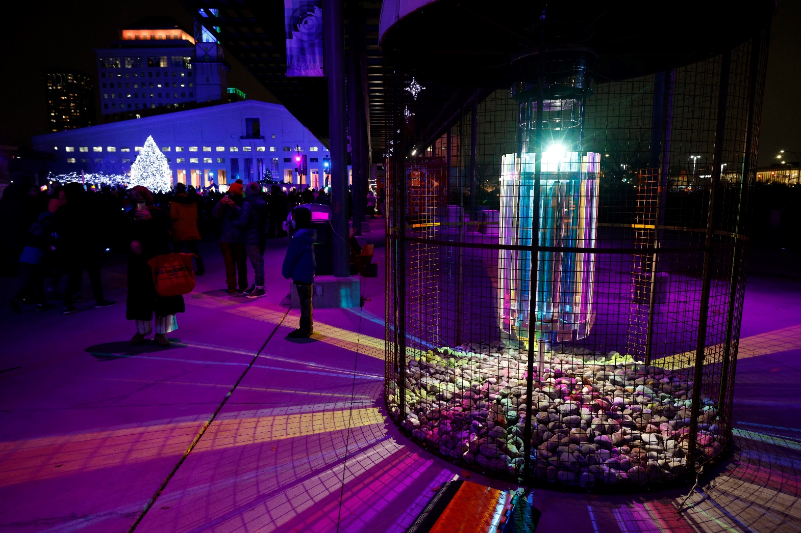
2019 Culture Master Plan
Notes:
(M)
Through the engagement for the 2019 Culture Master Plan – we heard that residents want more localized arts and culture scene to interact with in their daily lives, in their local neighbourhoods

Slide 12
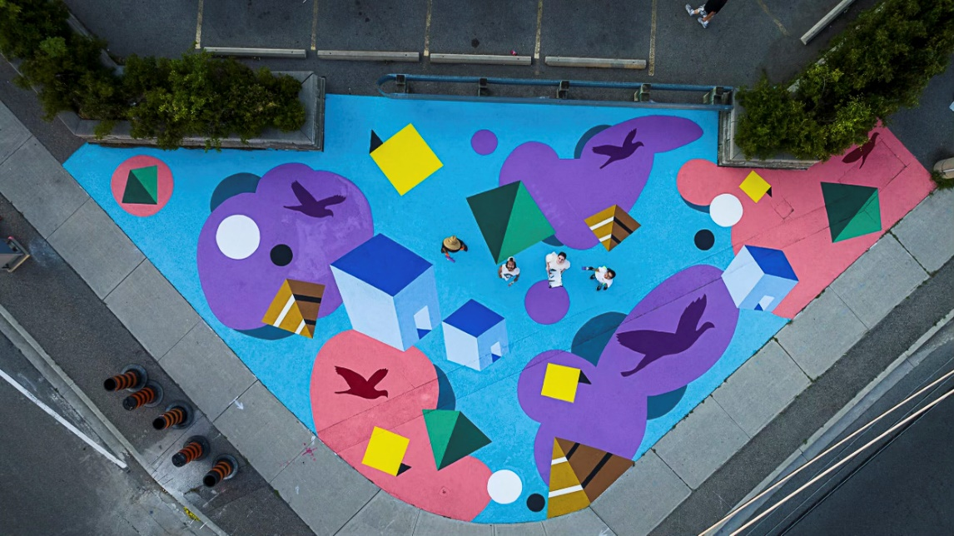
Cultural Districts Implementation
Notes:
(Z)
That’s where the need to strategically focus our efforts on identified neighbourhoods came from – to establish them as cultural districts so they can become local destinations

Slide 13
Cultural Districts Implementation
Port Credit
Streetsville
Cooksville
Clarkson
Malton
Downtown Core
Notes:
(Z)
These six neighbourhoods were identified as cultural districts
5 of them have a BIA, except the Downtown Core
It’s also important mentioning here that not all BIAs were at the same stage – BIAs such as PC and Streetsville were well-established, whereas neighbourhoods such as Clarkson and Cooksville were still in their early years of getting set up

Slide 14
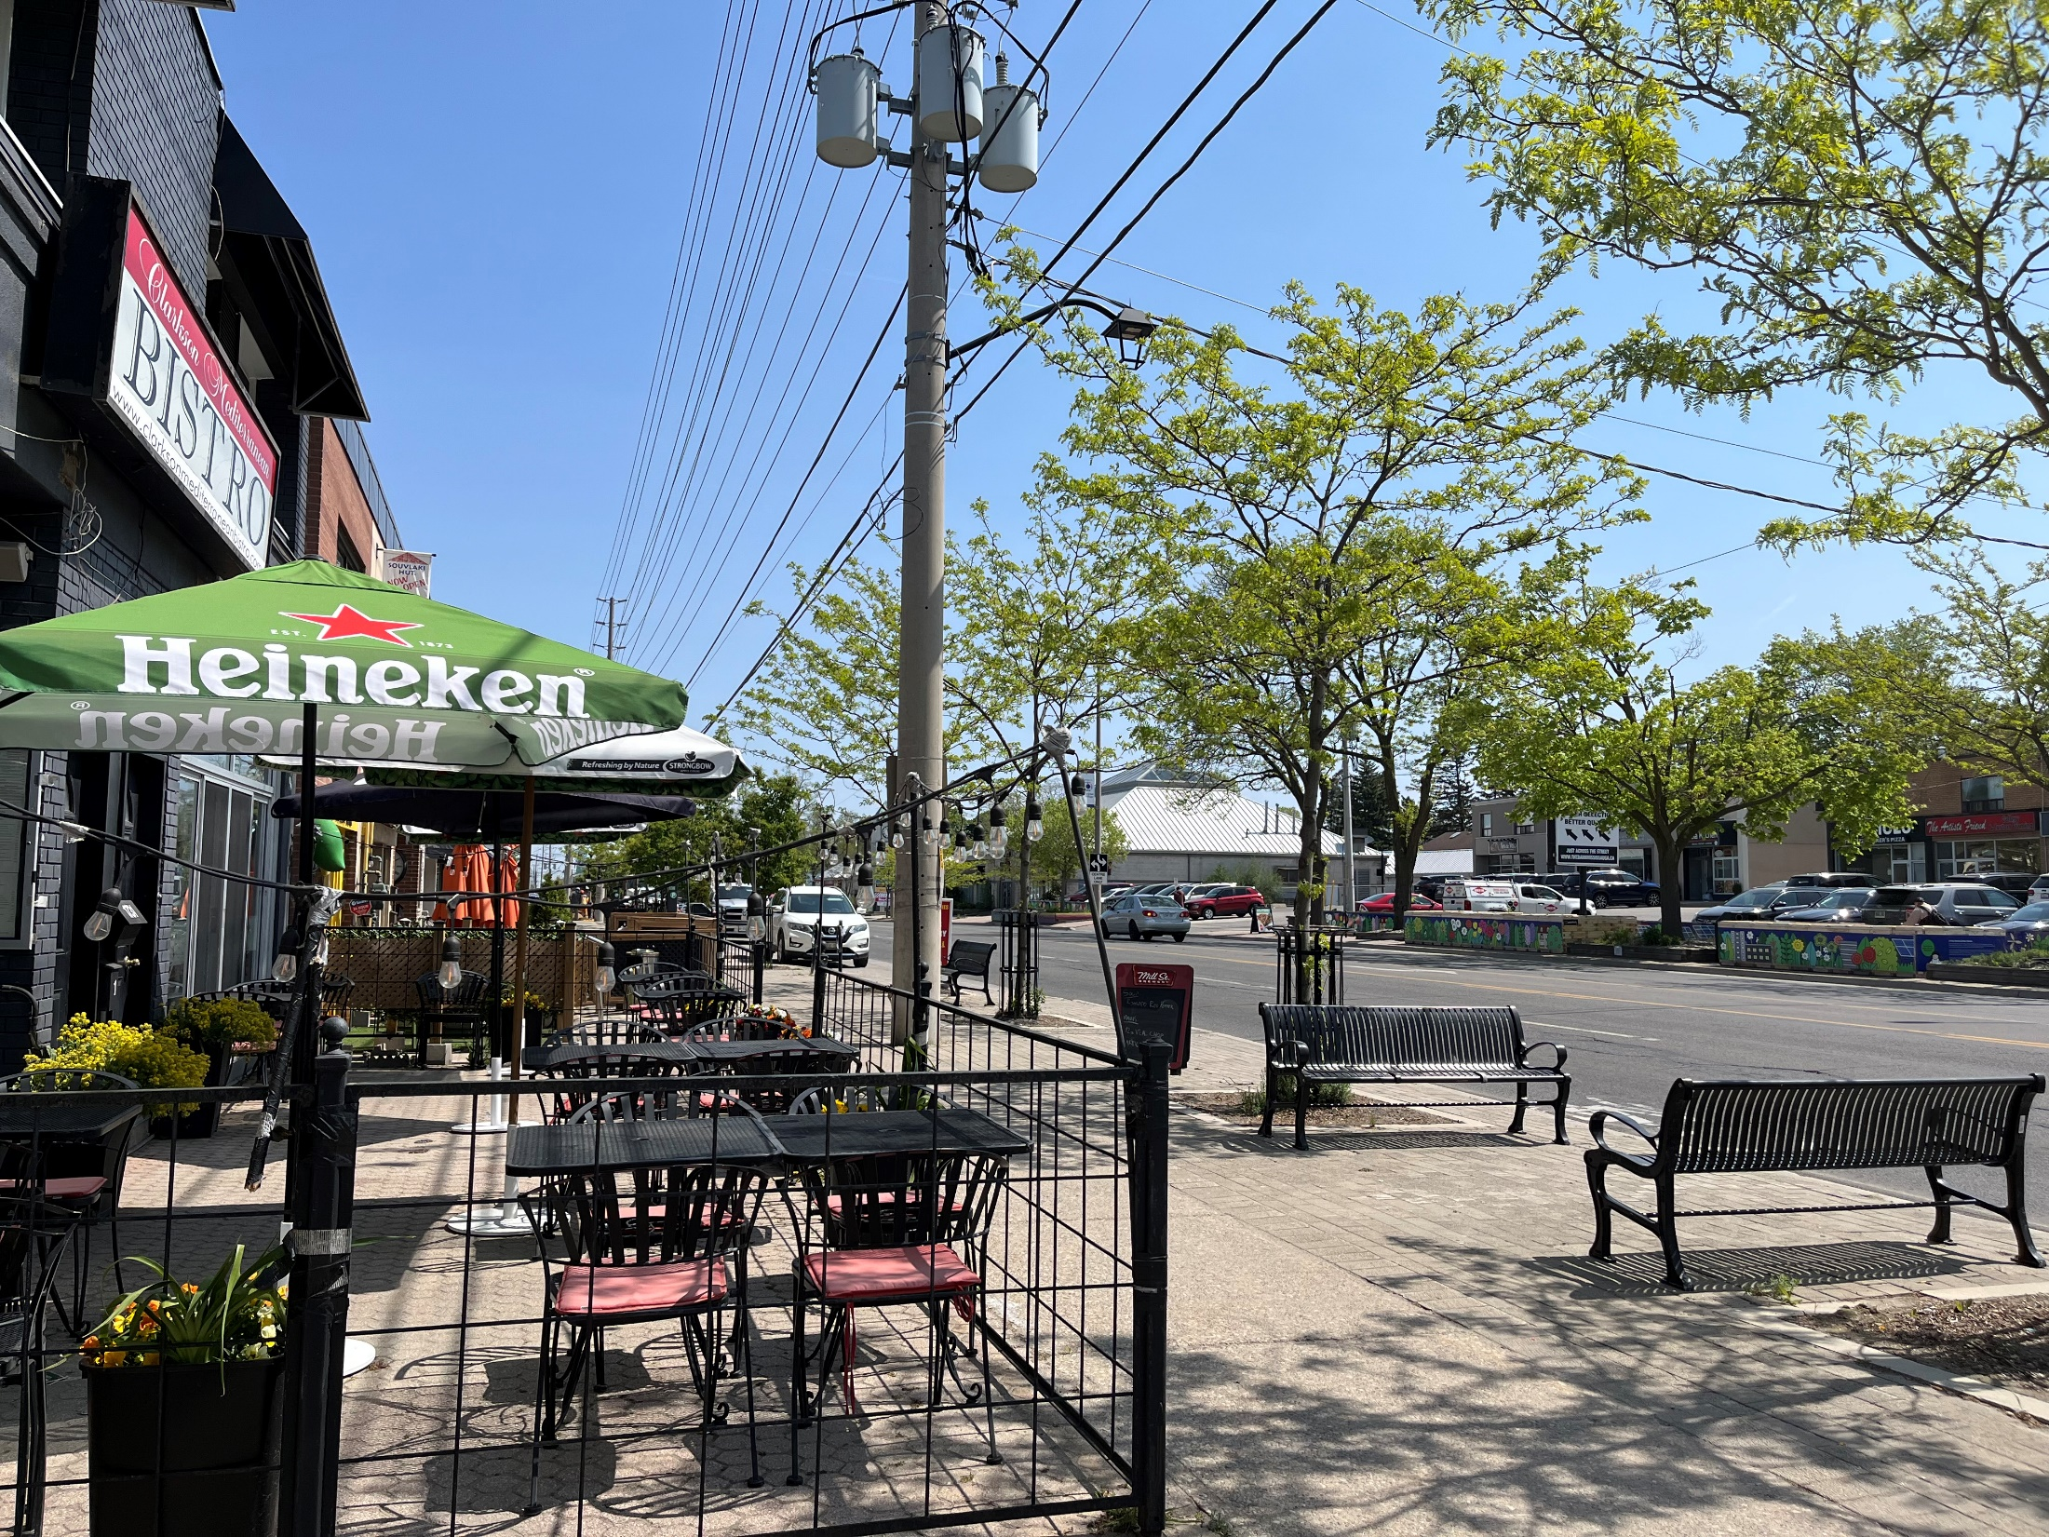
Themes & Boundaries
Themes & Boundaries
Notes:
(Z)
Themes & Boundaries
Geographic boundaries have been identified for each Cultural District, which largely aligns with the existing BIA boundary – in addition we’ve included parkland, and some commercial parcels of land that have potential for re-development in the future that could contribute to a Cultural District
The boundaries are intended to provide an initial area of focus for the initiative and any land or zoning related exemptions – it does not mean we wouldn’t consider anything happening outside of the boundary
The boundaries are fluid and may be revised in the future as BIA boundaries also change

Slide 15
Boundaries
Notes:
(Z)
Themes & Boundaries
Here is an example of the Clarkson Cultural District boundary – which largely aligns with the BIA boundary, with Lakeshore Rd running through it as a spine and center for activity
We also want to acknowledge there are opportunities outside of these borders as well – such as with Clarkson, there are nearby Museum properties which we’ve identified with the arrows here – to visually illustrate the connection to those and potential opportunities

Slide 16
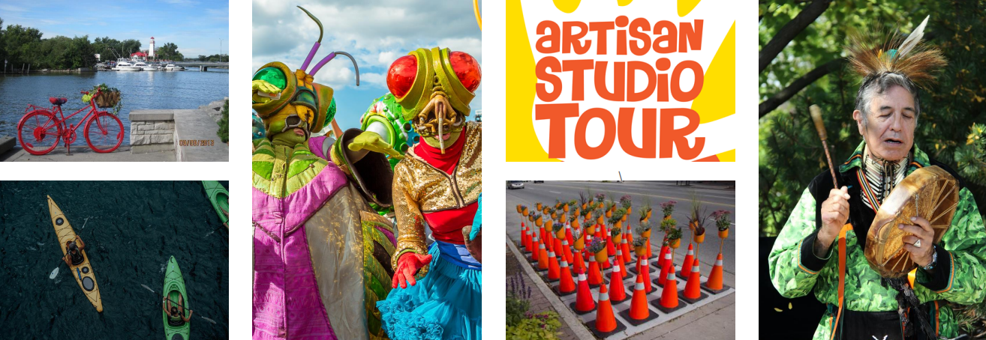

Themes
Port Credit
Exploration
Entertainment
The Arts
Cultural Heritage
Notes:
(Z)
Themes
Port Credit is a place for…
Exploration
Waterfront Parks, Marina, local kayaking & canoe clubs, rowing, boat launches, fishing
Entertainment
Festivals, restaurants, outdoor patios, Summer Concert Series, Sauga Busks
The Arts
Art galleries, studios, public art, Arts on the Credit programming
Cultural Heritage
Indigenous Heritage – Mouth of the Credit River, Marina industry, Port Credit HCD, brick manufacturing & oil refinery legacy
Intent with the themes is – what would this inform

Slide 17
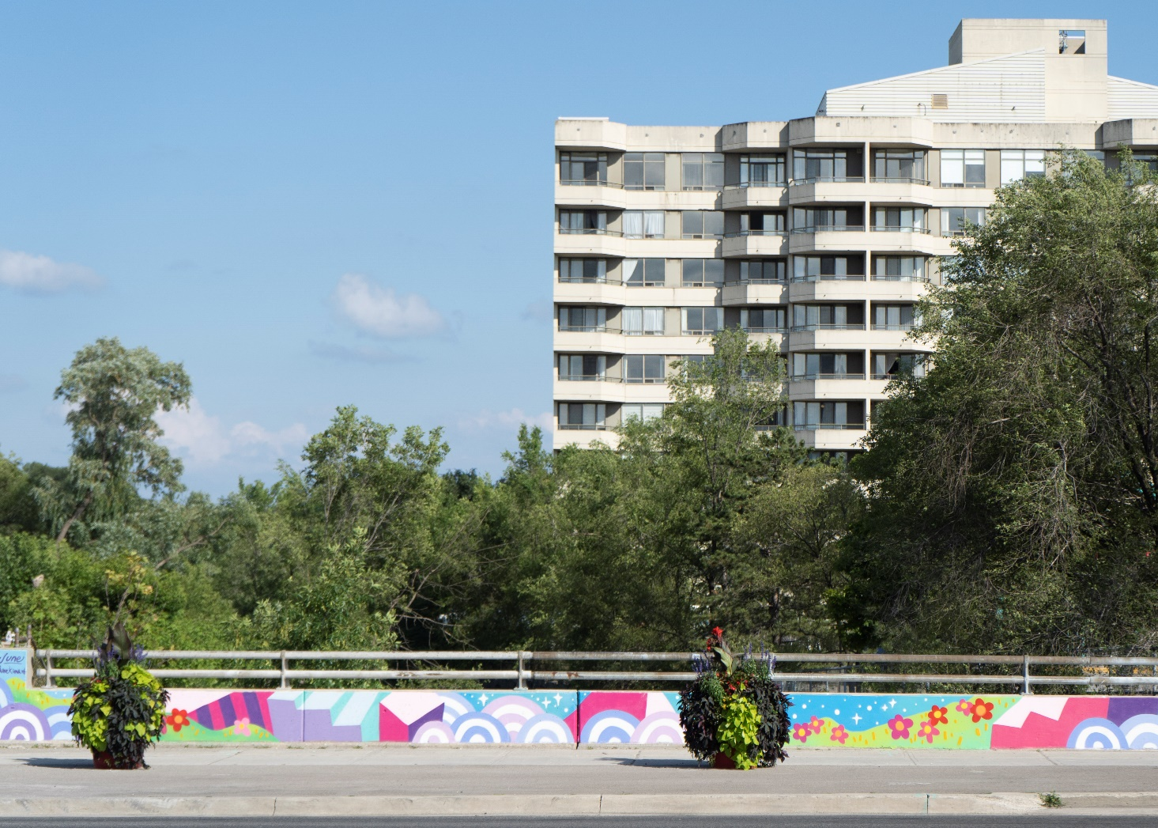
The City’s Role
The City’s Role
Jieun June Kim, Jaguar Valley Murals, 2022. Cooksville, STEPS Public Art. Photography by Kyle Jarencio.
Notes:
(Z)
The City’s Role
Around the Cultural Districts project has been to provide greater support in the early years of the project, help build capacity, and play a more behind-the-scenes role in the long term

Slide 18
The City’s Role
The City’s Role
Reduce barriers
Make it easier for the community to participate
Provide support through starter initiatives
Support and empower BIAs
Foster local partnerships
Notes:
(Z)
The City’s Role
Reduce barrier to arts and cultural development and creative programming in the Cultural Districts through policy making
Make it easier for the community to participate in creative expression and community building
Support the Cultural Districts with starter initiatives
Support and empower the BIAs and business stakeholders, foster local partnerships to enhance the Cultural Districts
In the long term, we’re aiming to empower the BIAs and local org to do the on the ground work, provide support with grants, and provide administrative support

Slide 19
The City’s Role
The BIA’s role
To oversee the improvement, beautification and maintenance of municipally-owned land, buildings and structures in the BIA area
Full-time City staff person assigned as a liaison between BIA & the City
BIA Reference Guide
Notes:
(Z)
The BIA’s role
The BIAs oversee the improvement, beautification and maintenance of municipally-owned land, buildings and structured in the BIA area
This is another reason why it makes sense to closely align the boundaries – so that we can work together
We also have a full-time City staff person that is assigned as a liaison between the BIA and the City – this is the point person through which inquiries are directed to the appropriate staff, it ensure we’re all talking to one another and have streamlined processes
Our Liaison also developed a BIA Reference Guide recently – which is a great resource for City staff, and the BIAs:
It addresses questions specific City policies, processes and procedures that impact BIAs
It also provides more clarification on the Municipal Act and interpretation related to BIAs
Covers topics such as the laws that apply, governance, financial mgmt., capital work and maintenance, city insurance requirements, city & BIA maintenance and repair obligations

Slide 20
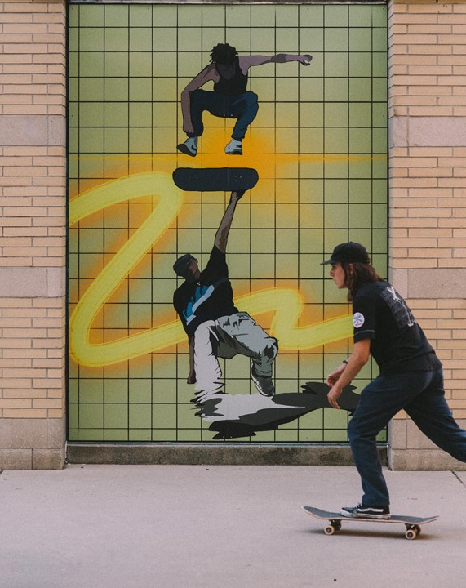
Framework for Recommendations
Policies, Studies & Guidelines
Programs & Initiatives
Community & Business Support
Partnerships
Public Realm Activations
Ray Vidal, Ebb and Flow, 2021. Civic Centre Skatepark. Photography by Tylor Key Carr.
Notes:
(M)
Framework for Recommendations
The Cultural Districts Implementation Plan includes a set of recommendations that apply cultural districts-wide, and specific opportunities identified for each cultural district. The recommendations are categorized into:
Policies, Studies & Guidelines
-actions to update City policies and permitting process to support arts and cultural uses and activities in the Cultural Districts
-example: public art on construction hoarding, culture opportunities & barriers review
Programs & Initiatives
-actions to develop new programs or initiatives and expand existing culture and public art programming to create vibrant public spaces and create opportunities for artists, youth and performers
-example: summer concert series, supporting the busking program by identifying locations in cultural districts
Community & Business Support
-actions to support community organizations, businesses and BIAs to activate the Cultural Districts
-example: Mississauga Made Tourism banner campaign during COVID-19, annual walkabouts to identify collaborative opportunities, I Heart Main Street Program & helping to cost-share on projects
Partnerships
-opportunities to collaborate with City, community and external partners on on-going projects and event programming
-example: annual walkabouts to identify collaborative opportunities, I Heart Main Street Program & helping to cost-share on projects
Public Realm Activations
-site-specific Cultural District activations which animate and activate spaces using tactics such as temporary public art, pop-ups and programming
-example: Placemaking Program & Roster

Slide 21
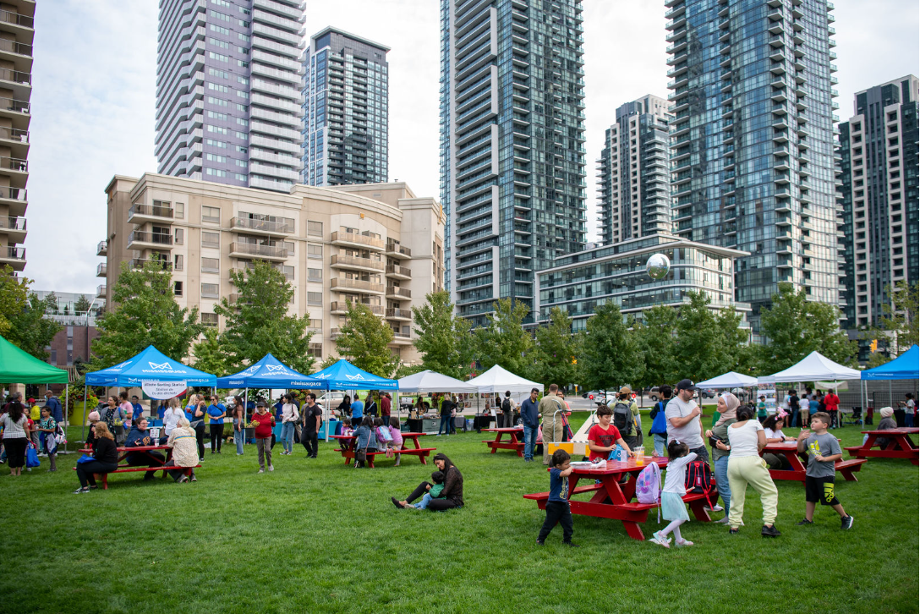
Policies, Studies & Guidelines
Notes:
(M)
Policies, Studies & Guidelines
This includes actions to update City policies and permitting process to support arts and cultural uses and activities in the Cultural Districts
One key example is integrating cultural districts in to the City’s Official Plan. We’ve included language at a high level to build support for the cultural districts at a policy level, to inform developers and to support us in leveraging opportunities for cultural infrastructure development or enhancements in the Cultural Districts
We’ve been involved in discussions around using Community Improvement Plans (CIPs) which is a tool available to municipalities to incentivize certain types of development. We’ve been researching how CIPs could incentivize cultural and creative uses in our Downtown Core, or how we could create neighbourhood-specific zoning policies that are very specific on types of uses (such as, how we have too many banks and Dr offices and pharmacies on the ground floor of buildings instead of active, unique retail uses that contribute to vibrancy at the street level – such as cafes, ice cream shops, studios.
Official Plan – Cultural Districts policy:
8.8.3 Arts and cultural development should be strategically focused within Cultural Districts to enhance their identity and foster them as local neighbourhood-based cultural destinations.
Cultural Districts will encourage:
active ground floor retail uses and an active streetscape;
vibrant, inviting and animated public realm and spaces that contribute to a sense of place and encourage community gathering;
creative and cultural uses in unconventional spaces such as bus stops, vacant storefronts, underused parking lots, and privately owned public spaces (POPS);
co-location of creative and community uses, where appropriate;
public art and creative placemaking which celebrates the neighbourhood’s distinct identity, heritage, history and culture and engages the local community; and
heritage interpretation which highlights the neighbourhood’s history and Indigenous cultural heritage, and strengthens its distinct identity.

Slide 22
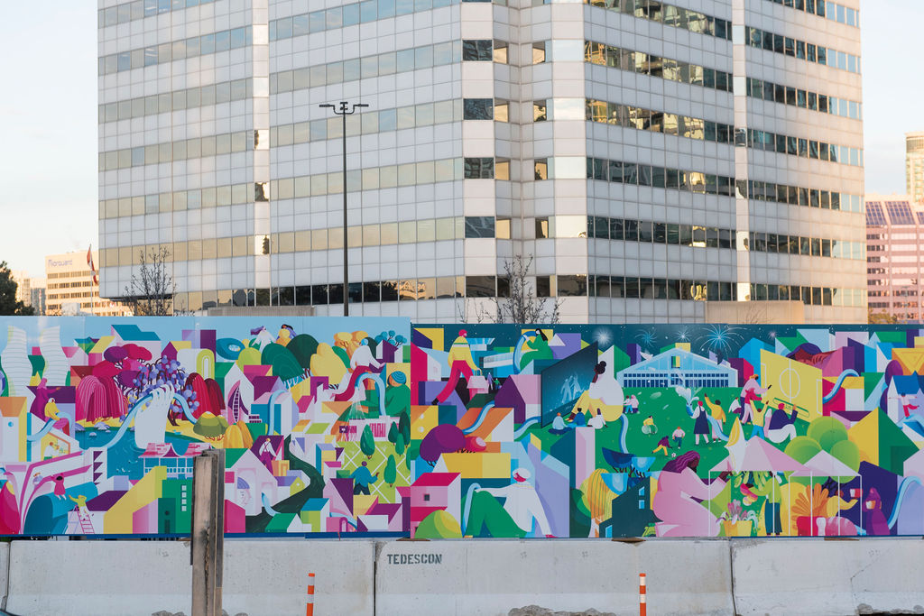
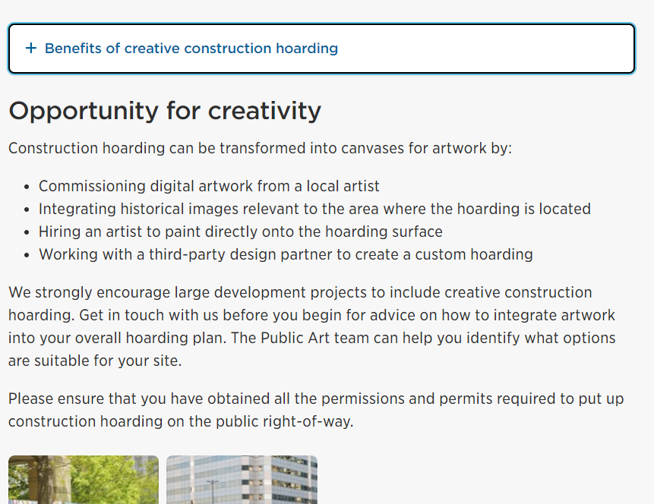
Public Art on Construction Hoarding
Wenting Li, City Builders, 2018. Burnhamthorpe Road West. Photography by Sharon Mendonca.
Notes:
(M)
Public Art on Construction Hoarding
Another example has been to strongly encourage public art on construction hoarding in the Cultural Districts
We’ve developed a webpage to provide guidelines and helpful information
We’ve also started commenting on development applications in the cultural districts and on main streets we have been requesting developers to install public art or beautified construction hoarding
We’re still navigating how we can make this a requirement instead of just encouraging

Slide 23
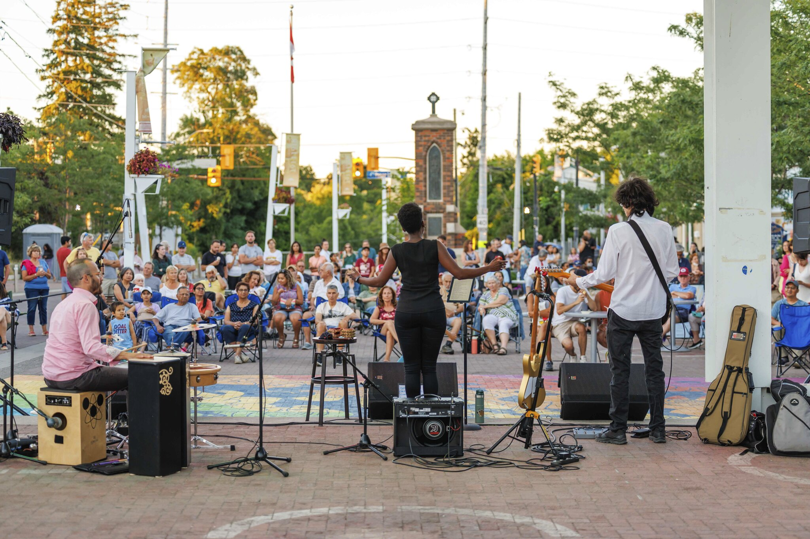
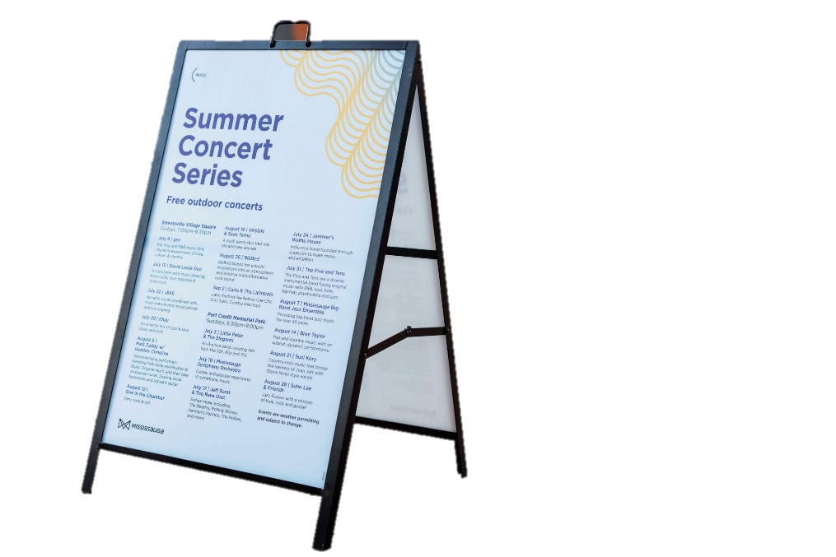
Programs & Initiatives
Notes:
(Z)
Programs & Initiatives
Actions to develop new programs or initiatives and expand existing culture and public art programming to create vibrant public spaces and create opportunities for artists, youth and performers
A very successful program that our Music Office runs is the Summer Concert Series, and a Busking Program, that we have supported and identified additional locations in Cultural Districts for .
The Summer Concert Series happens in public squares in Port Credit, Streetsville (pictured here) and Cooksville to bring live, local music to Mississauga throughout the summer – with over a dozen shoes each summer season.

Slide 24
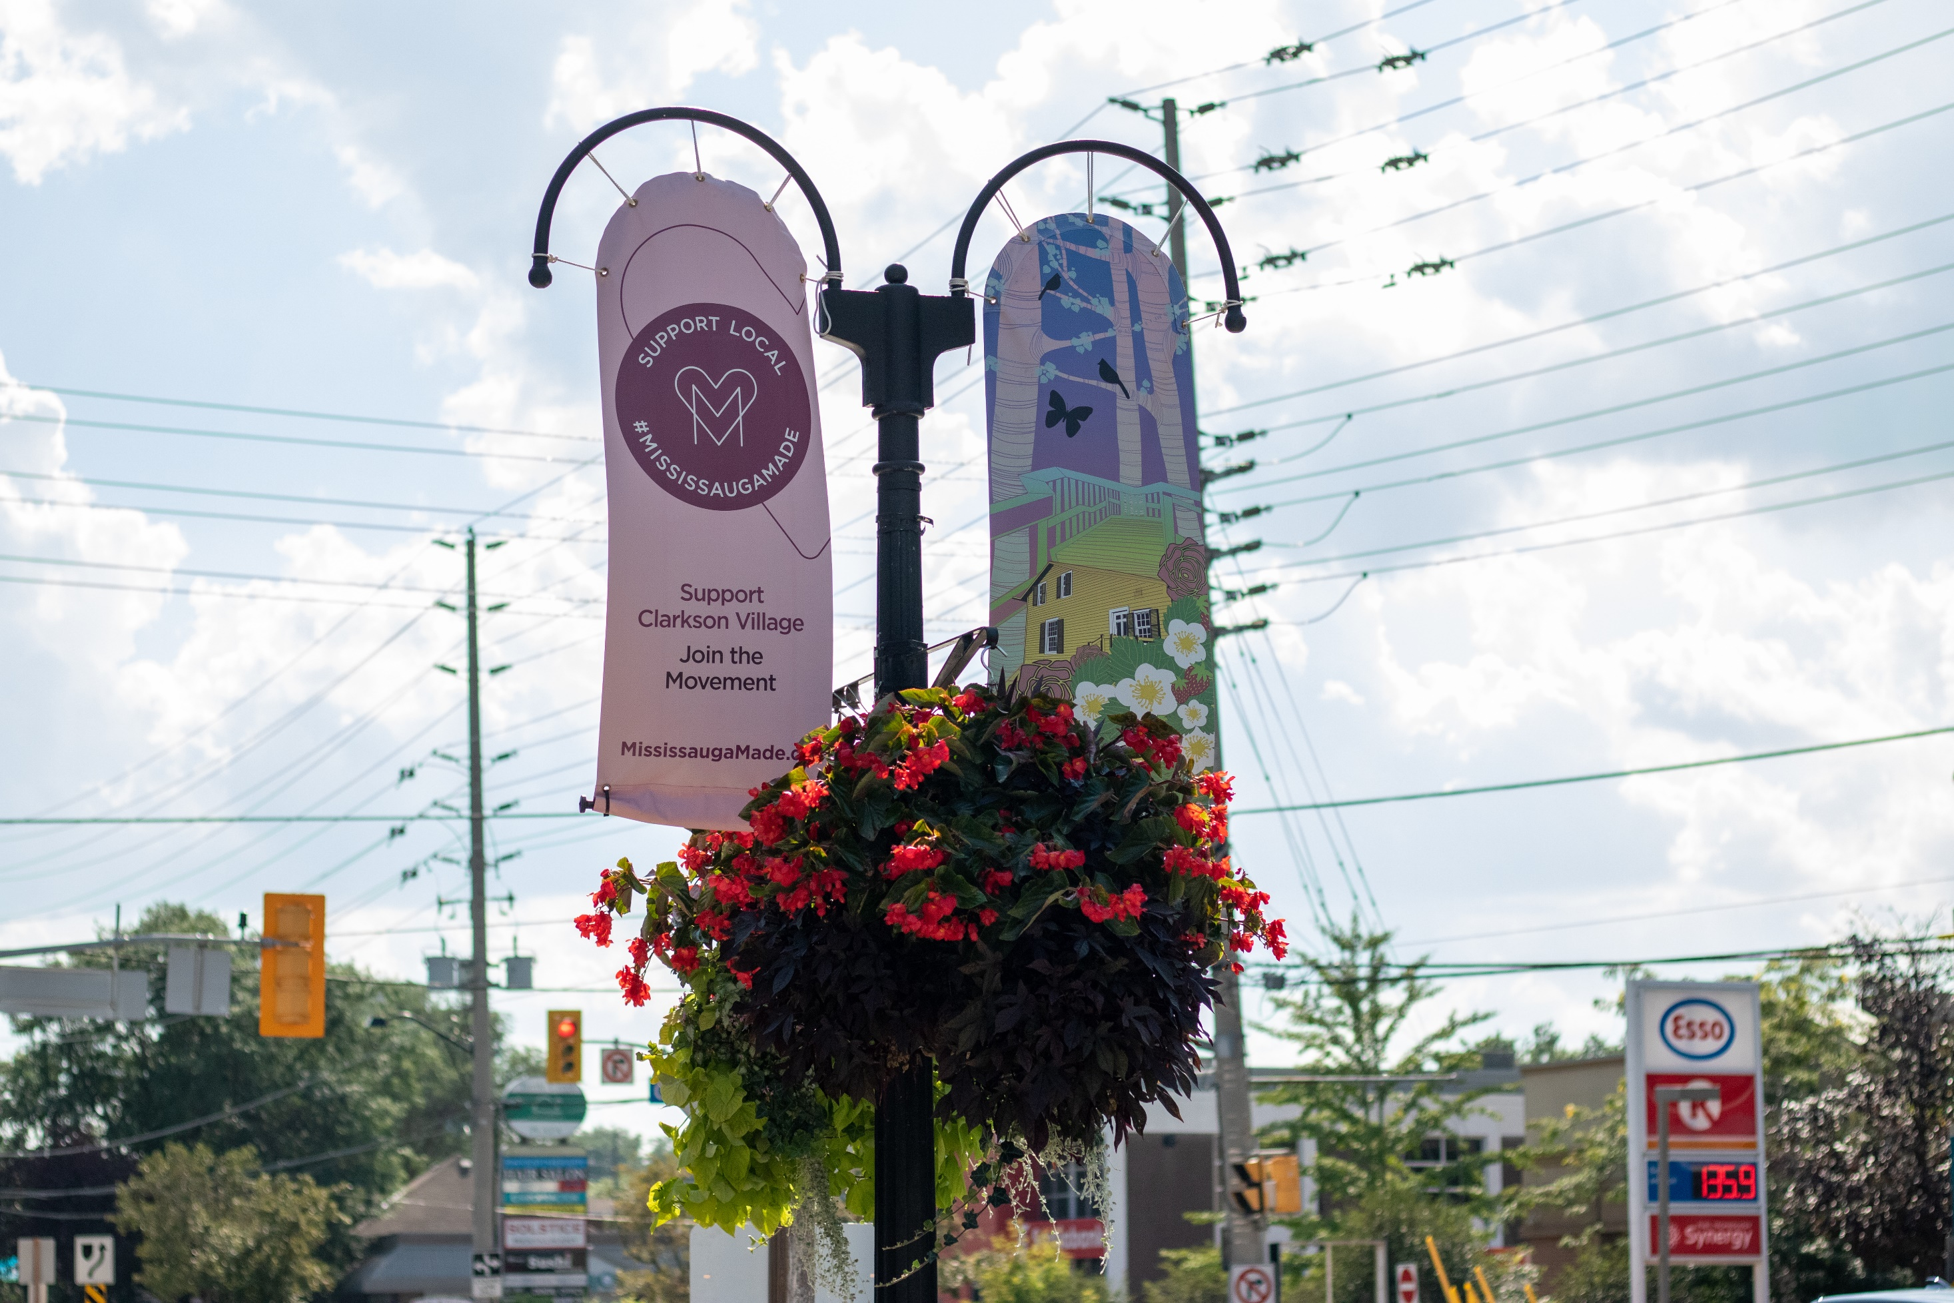
Community & Business Support
Pranavi Suthagar, Mississauga Made Tourism Banner Campaign, 2020. Photography by Tori Lambermont.
Notes:
(Z)
Community & Business Support
Actions to support community organizations, businesses and BIAs to activate the Cultural Districts
One of ways we supported BIAs during the COVID-19 pandemic was through a Tourism Campaign – Mississauga Made which encouraged everyone to shop local
We commissioned an artist to design banners for each BIA and half the banners includes public art and half included ‘shop local’ messaging and tourism branding
This was a cost-sharing project with Tourism Mississauga, and the City covering the artist fees, doing the project management, covering the fabrication costs, while the BIAs covered installation costs

Slide 25
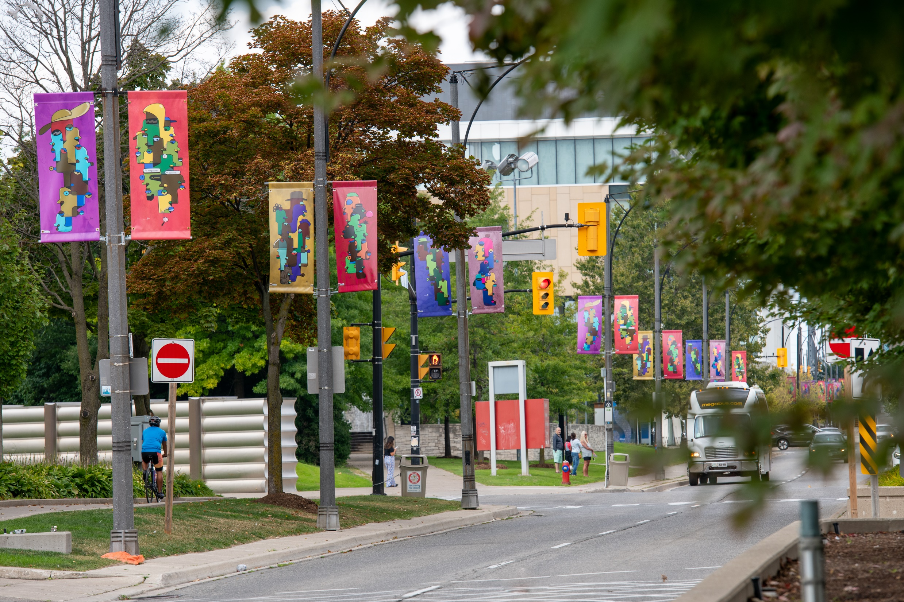
The City’s Banner Program
Ai, Summer connections, 2022. City of Mississauga Temporary Public Art Collection. Photography by Tori Lambermont.
Notes:
(Z)
Banner Program
Example: Mississauga’s 50th Anniversary – City-wide banners – cost sharing with the BIAs – we commissioned an artist who has created a unique banner design for each of the BIAs

Slide 26
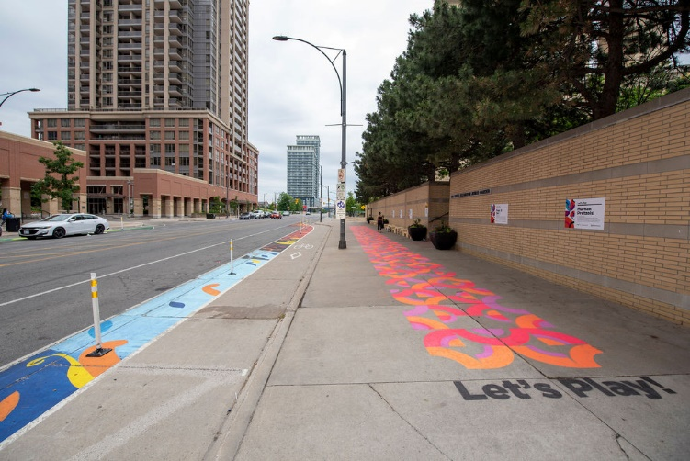
Partnerships
Notes:
(Z)
Partnerships
Opportunities to collaborate with City, community and external partners on on-going projects and event programming
Many of these partnerships kind of arose organically through regular discussions with staff from across the City
Here is an example of a project that was a partnership between Urban Design, Active Transportation and Public Art
Urban Design’s tactical urbanism led a pilot on Living Arts Drive, which aimed to increase walkability and create more opportunities for play - included added seating, play opportunities, and we collaborated with them & Active Transportation by doing a public art mural in the bike lane by Moonlight Murals Collective

Slide 27
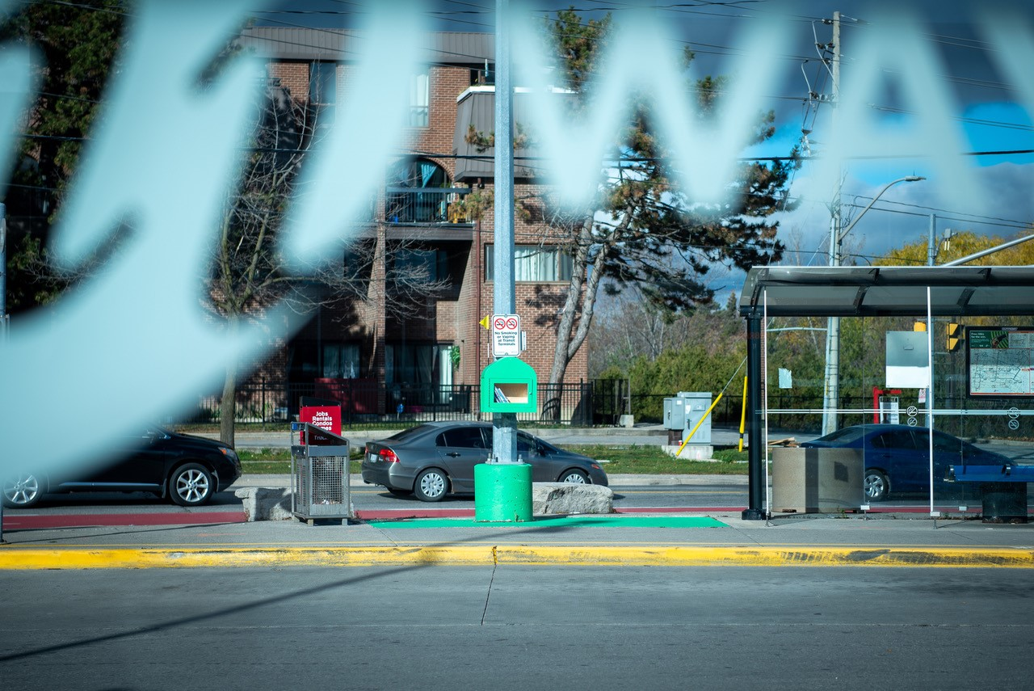
Public Realm Activations
SHEEEP Studio, Community Exchange Pods, 2022. Westwood Transit Terminal, Malton, Photography by Tori Lambermont.
Notes:
(Z)
Public Realm Activations
Site-specific Cultural District activations which animate and activate spaces using tactics such as temporary public art, pop-ups and programming
We’ll be sharing lots of examples of these activations with you today when we talk about our Placemaking Program

Slide 28
Q&A
What kinds of post-pandemic recovery initiatives did your local municipality launch to support local art and cultural initiatives? And/or to support your BIA and main streets?
What efforts did your BIA launch to encourage people to support local businesses and invite visitors to the area?
Notes:
(M)
On the topic of COVID-19 pandemic recovery, we’ll pause here to open up discussion on post-pandemic recovery initiatives.

Slide 29
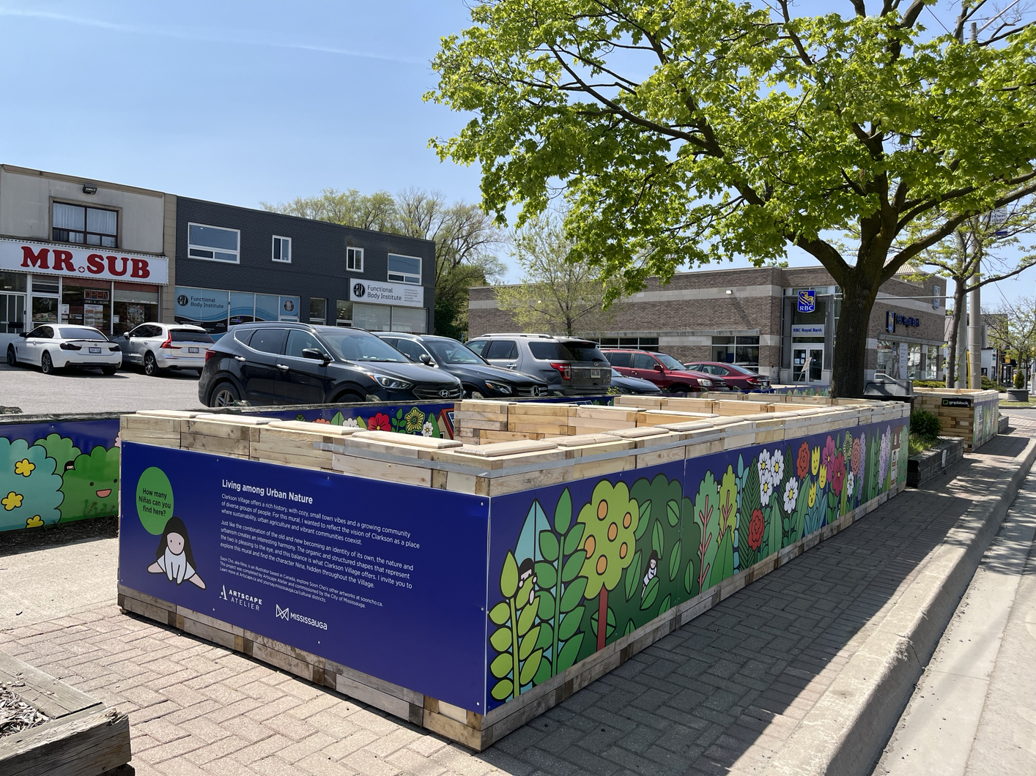
Placemaking Program
Soon Cho, Living in Urban Nature, 2023. Clarkson, Artscape Atelier.
Notes:
(M)
Placemaking Program
During the pandemic we secured $500,000 in municipal funding from the Arts Reserve to expedite placemaking projects in the Cultural Districts to support with pandemic recovery with cultural investment in the main street neighbourhoods.
We developed a roster with 14-15 creative firms, local arts organizations to hire for the projects.

Slide 30
Placemaking Program
Went through a HVA process to build a roster of creative firms, arts organizations to expedite placemaking projects
Third party delivery model for temporary public art and placemaking projects
Notes:
(M)
Placemaking Program
We went through a high value acquisition process to build a roster of creative firms and arts organizations to expedite placemaking projects
This would follow a third-party delivery model
The benefits of this: expanding out capacity, ability to quickly respond to requests, ability to leverage funds received from BIAs (STEPS I Heart Main Street)
BIAs applied for the STEPS grant, STEPS was on our roster – easy to partner with them

Slide 31
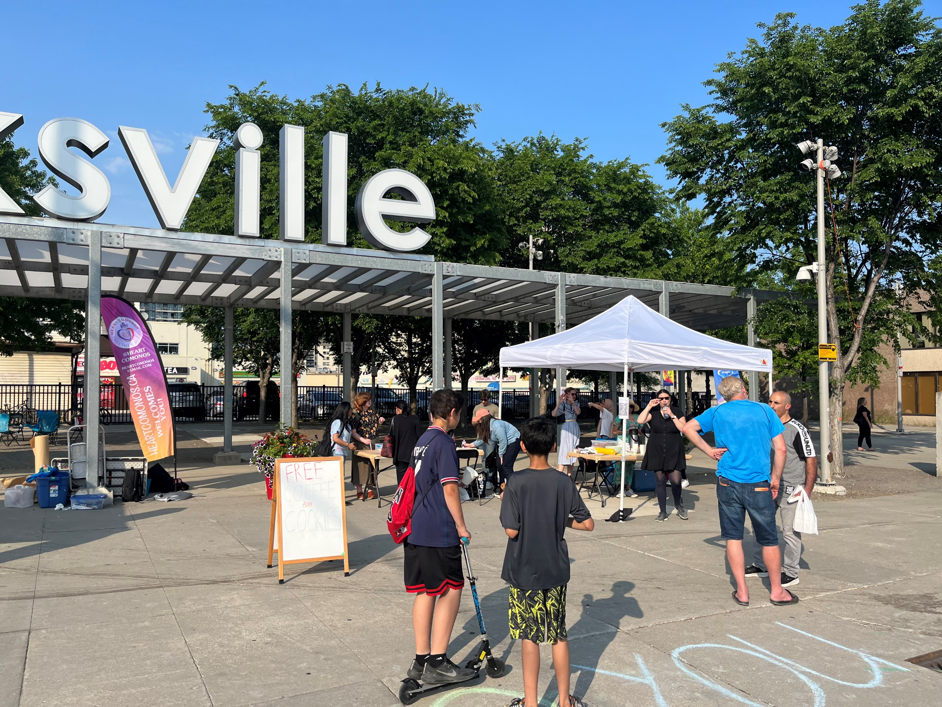
Place-making & Place-keeping
Notes:
(Z)
Placemaking & Placekeeping
Speak to Placekeeping especially in the case of Cooksville, and how through our projects we’ve aiming to share the neighbourhoods’ history, storytelling, and unique characteristics.
There are pressures in Cooksville through future developments that will impact local businesses in the BIA, largely due to the Hurontario LRT which will run through the centre of this neighbourhood
There are 17 new residential towers (with some commercial footprint) approved or in the works, and we are expecting more applications in the future with further intensification near the LRT corridor
Each placekeeping or placemaking project that we’ve developed we’ve been cognizant of the local conditions and working with the community, with what already exists
In our RFPs for the projects we’ve built in requirements to work with local businesses where possible – whether that is for printing, ordering food, hosting or renting space

Slide 32

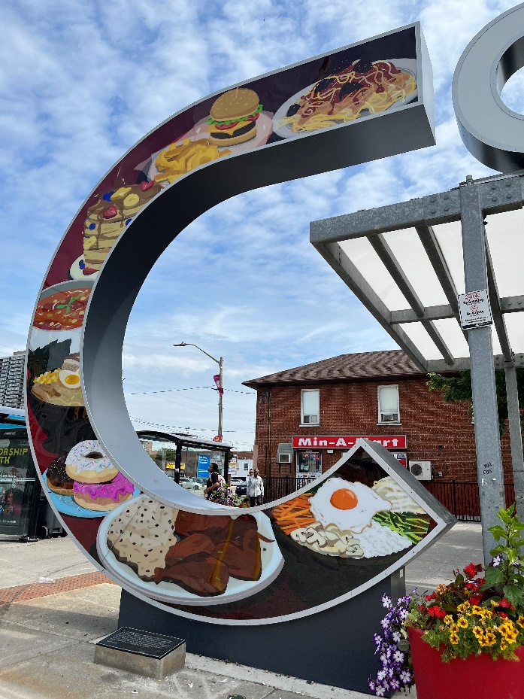
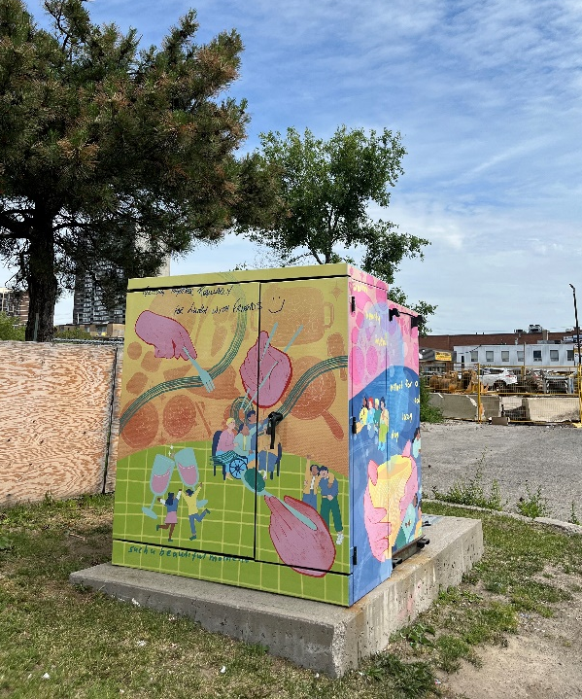
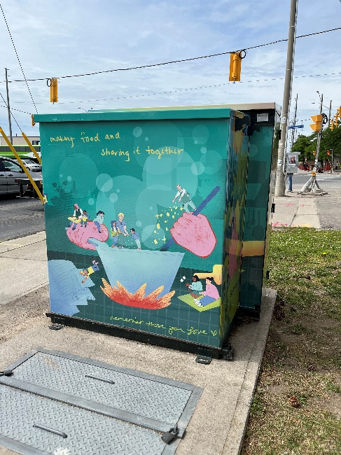
Reducing Redtape
Our Food Stories: Cooksville
Ashley Mozo, Debbie Woo, Our Food Stories: Cooksville, 2022. Cooksville Four Corners, Cooksville, STEPS.
Notes:
(Z)
Our Food Stories: Cooksville

Slide 33
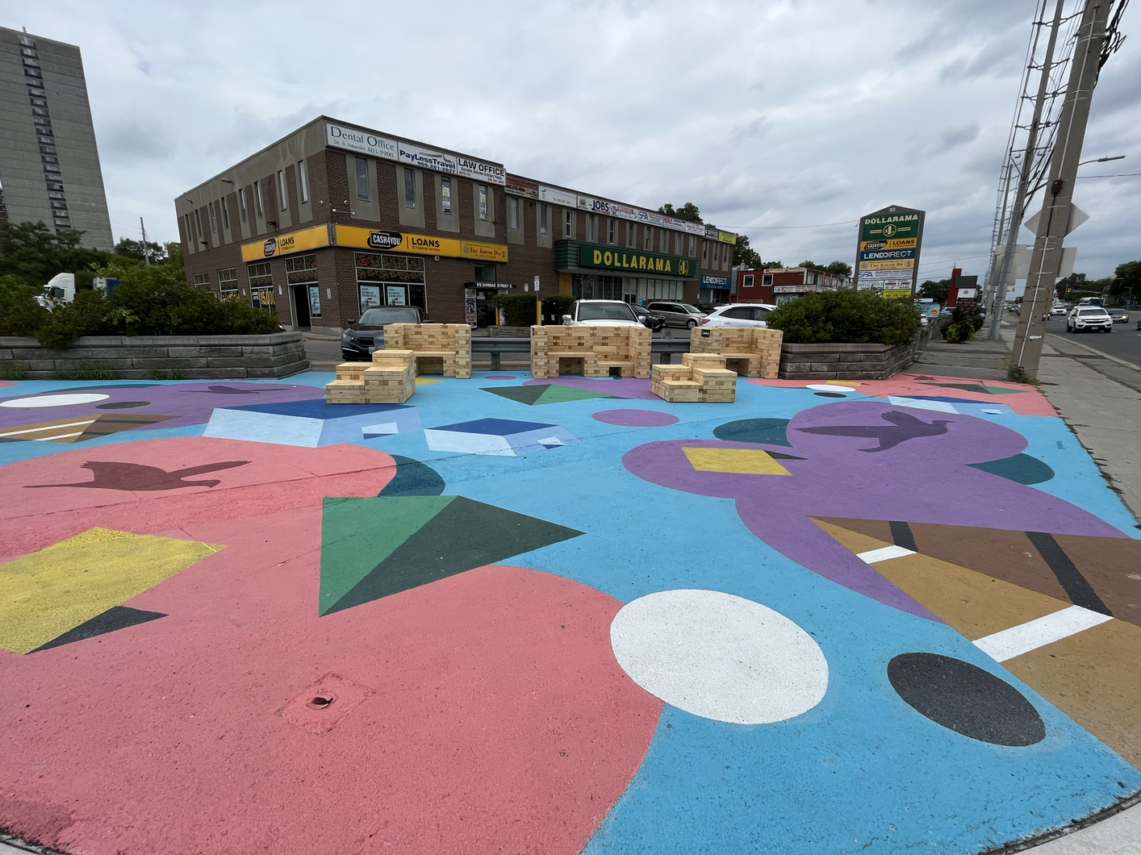
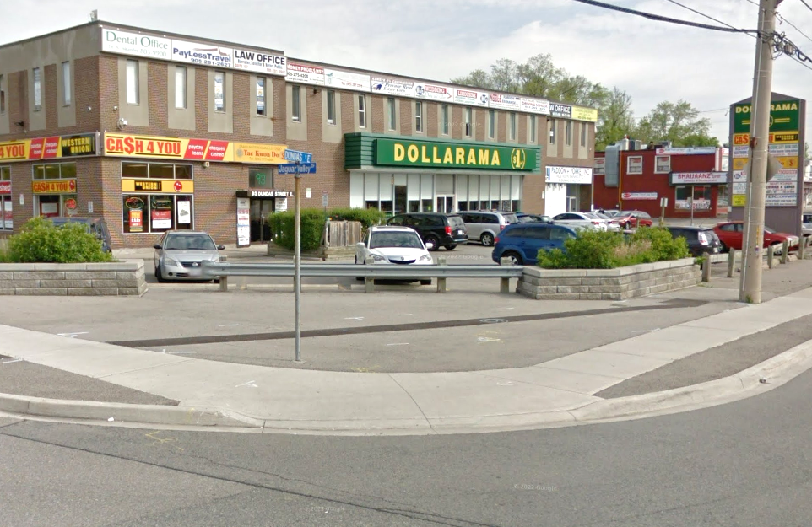
Reducing Redtap
Jaguar Valley Murals
Notes:
(Z)
Cooksville Ground Mural
Identified this corner as a potential public art and beautification opportunity

Slide 34
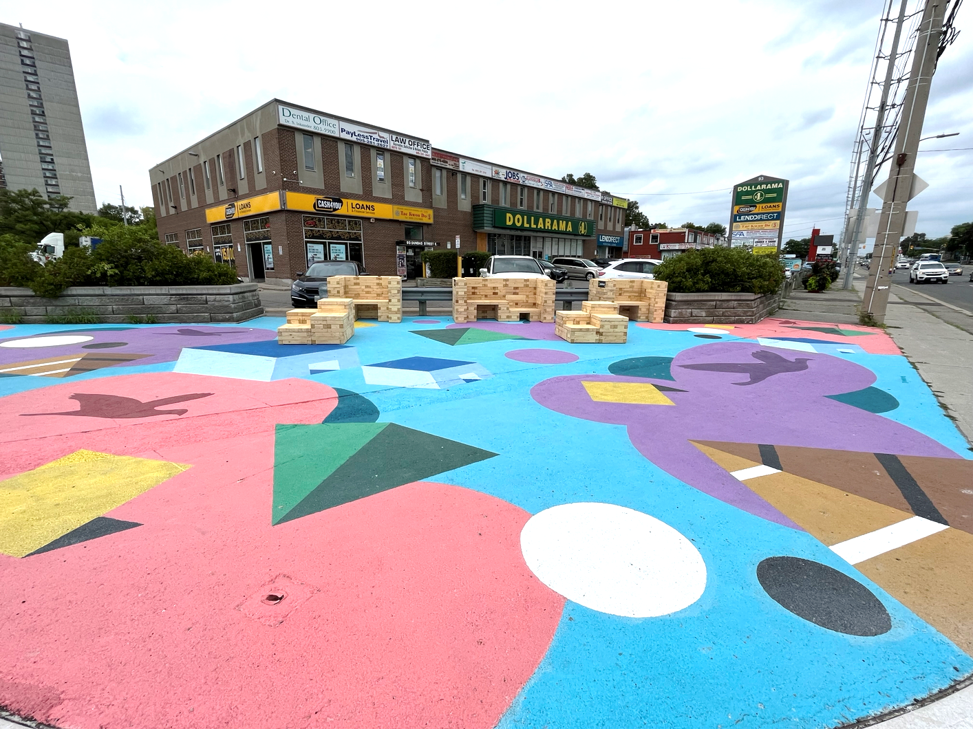
Reducing Redtap
Jaguar Valley Murals
Andre Kan, Jaguar Valley Ground Mural, 2022. Cooksville, STEPS.
Notes:
(Z)
Cooksville Ground Mural
Collaboration with Urban Design’s tactical urbanism work –they were planning on introducing some traffic calming measures, additional seating, playful activities and a mini library and to host a series of events on Jaguar Valley this summer
We engaged with the BIA early on as well – to get their feedback on this location

Slide 35
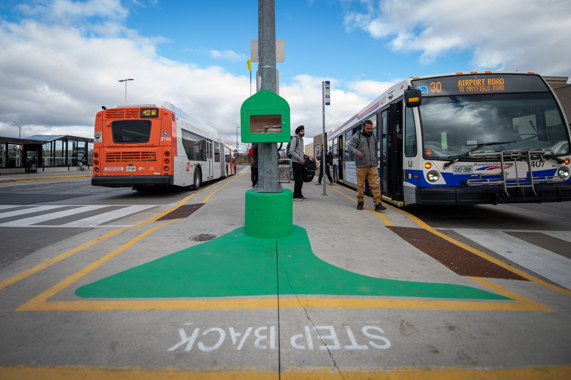
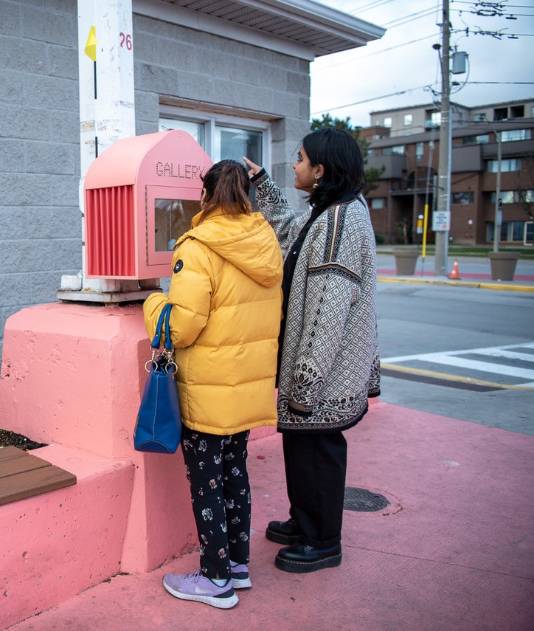
Reducing Redtape
Community Exchange Pods
SHEEEP Studio, Community Exchange Pods, 2022. Westwood Transit Terminal, Malton, Photography by Tori Lambermont.
Notes:
(Z)
Placemaking Program
Community Exchange pods – concept of mini free libraries – take a book, leave a book
Bring vibrancy to a popular transit terminal
First time doing a placemaking project at a transit terminal

Slide 36
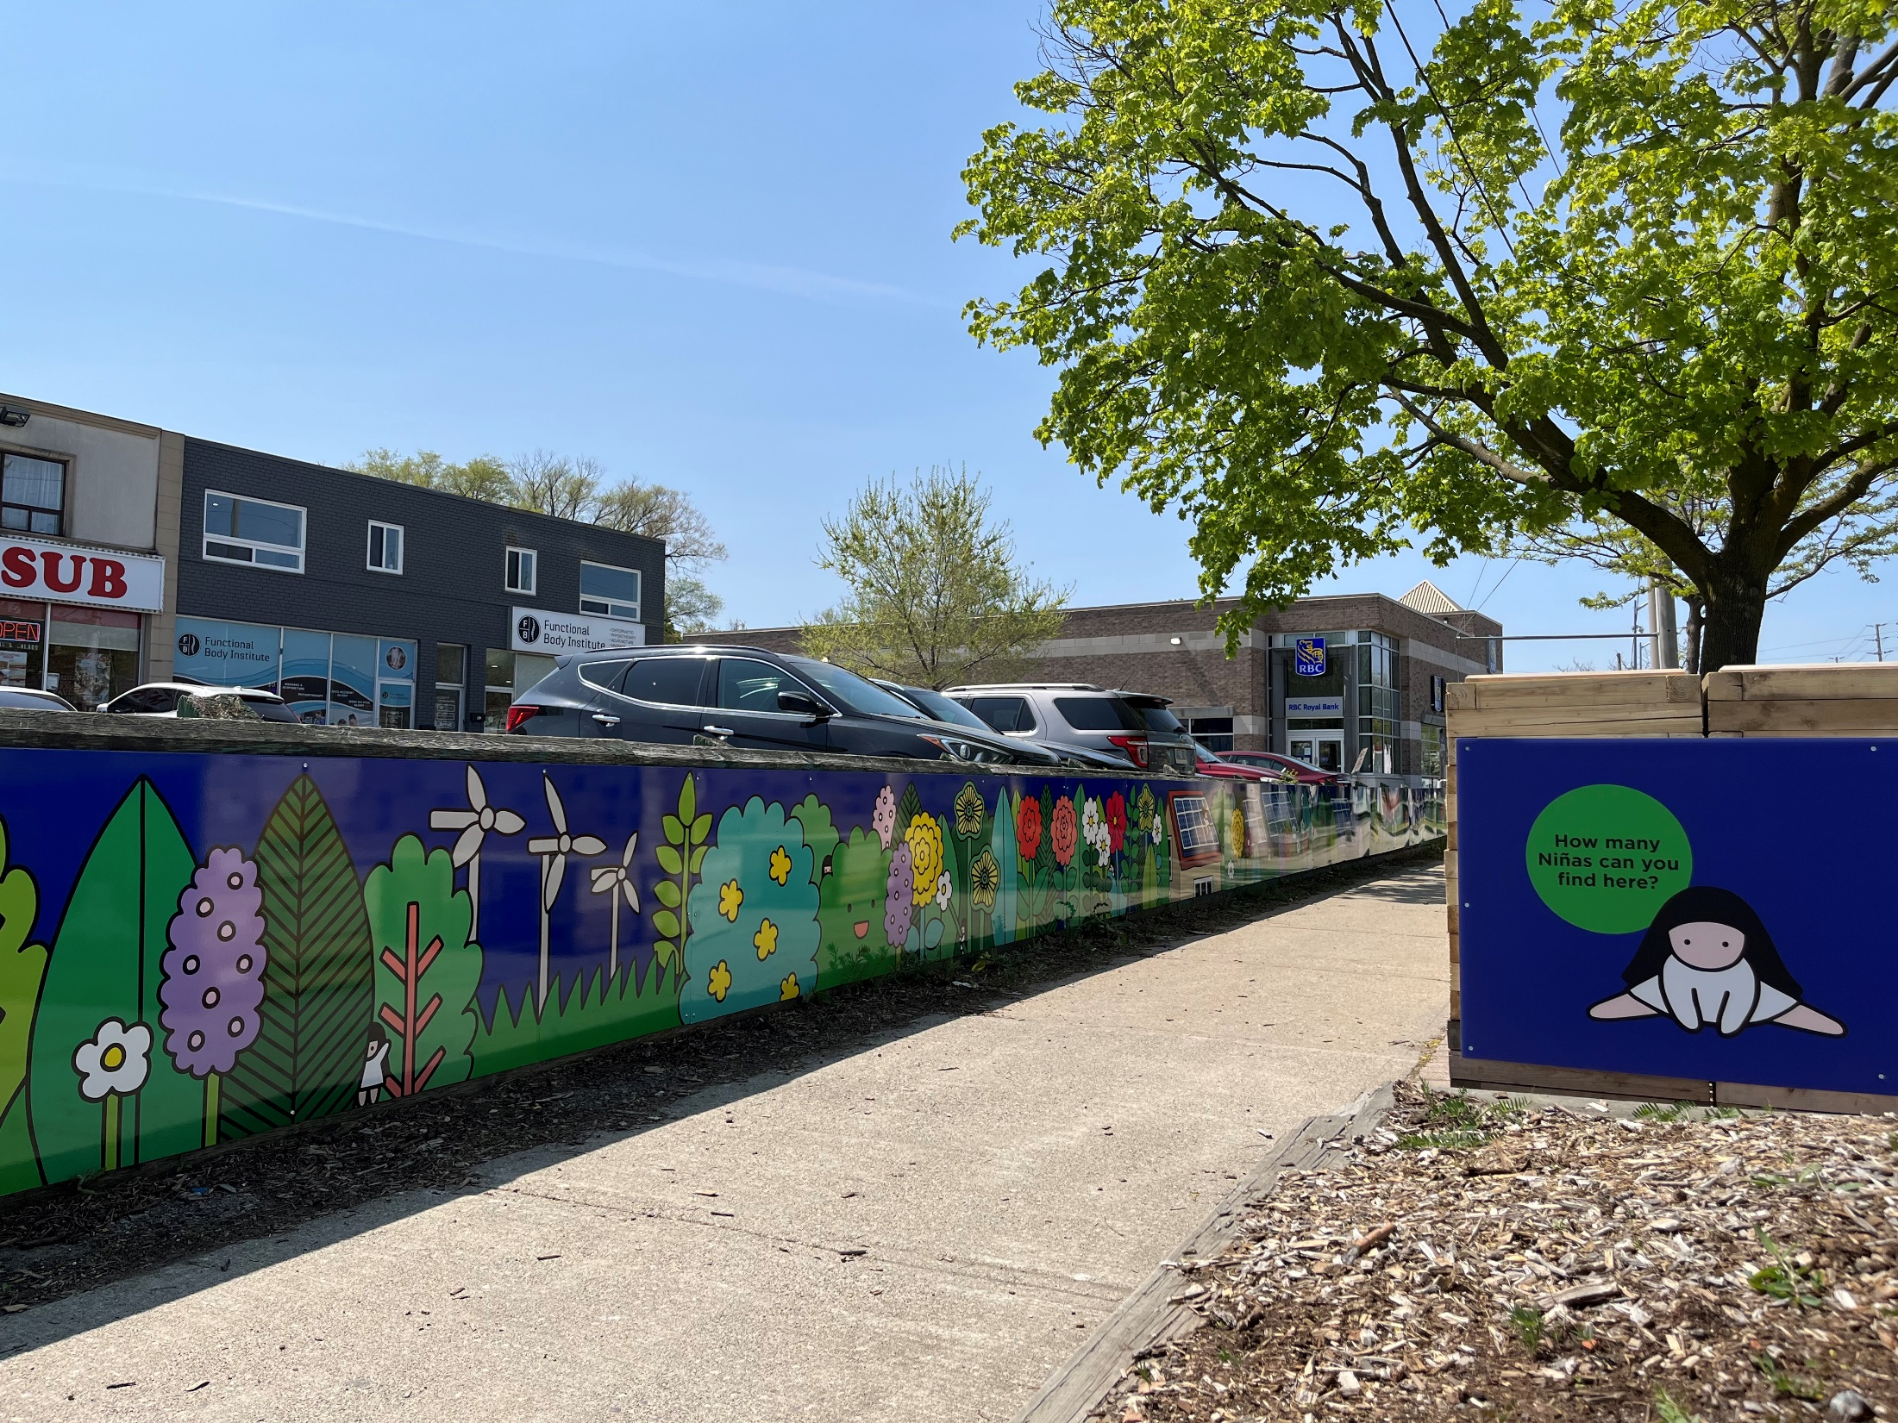
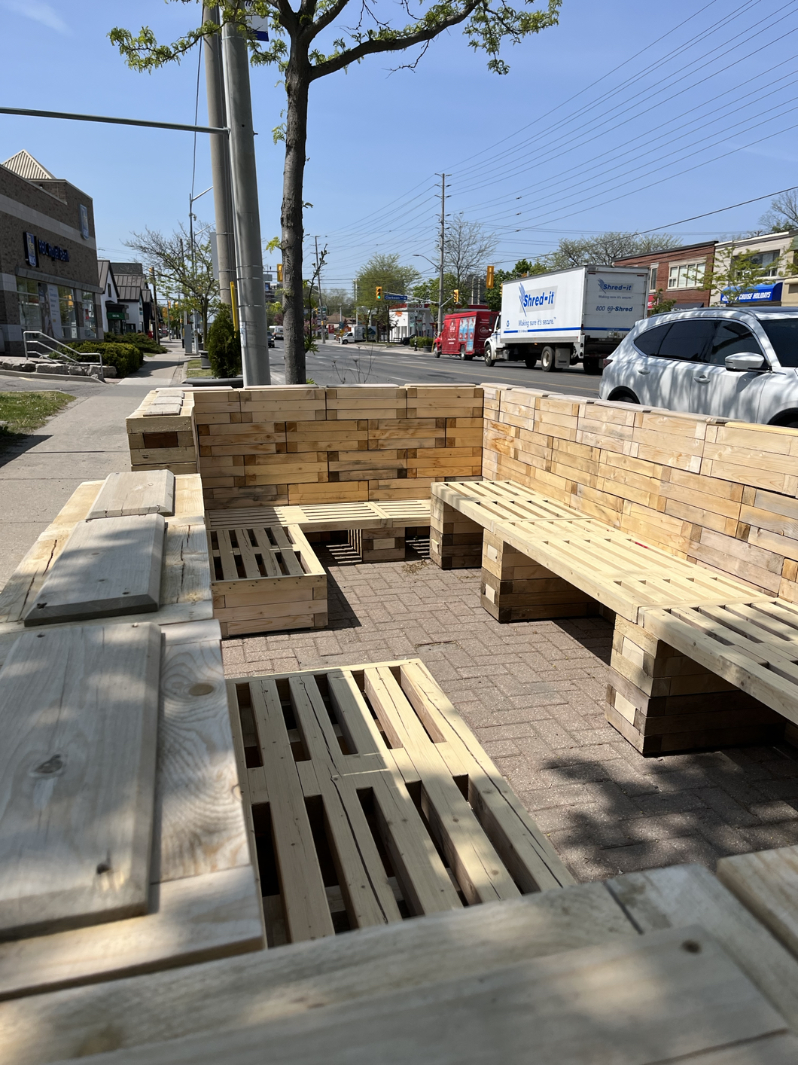
Reducing Redtape
Clarkson Murals & Pop-up Seating
Soon Cho, Living in Urban Nature, 2023. Clarkson, Artscape Atelier.
Notes:
(Z)
Artscape
Green retaining wall – identified as an opportunity through the annual BIA walkabouts
We put this out to the roster to come up was ways to beautify the wall
Gripblock seating – a rental product – this helped provide seating in a neighbourhood / main street area that lacks public seating or gathering space or square

Slide 37
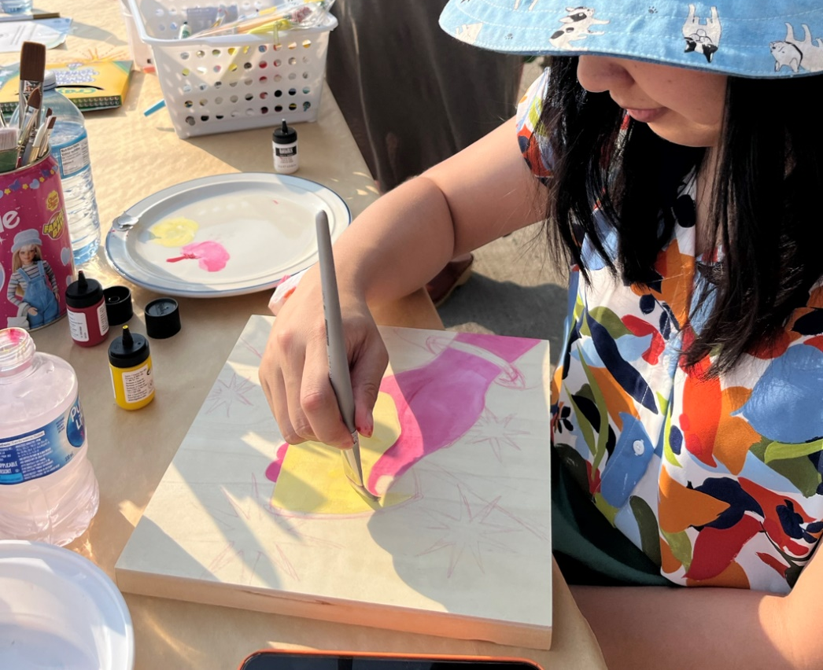
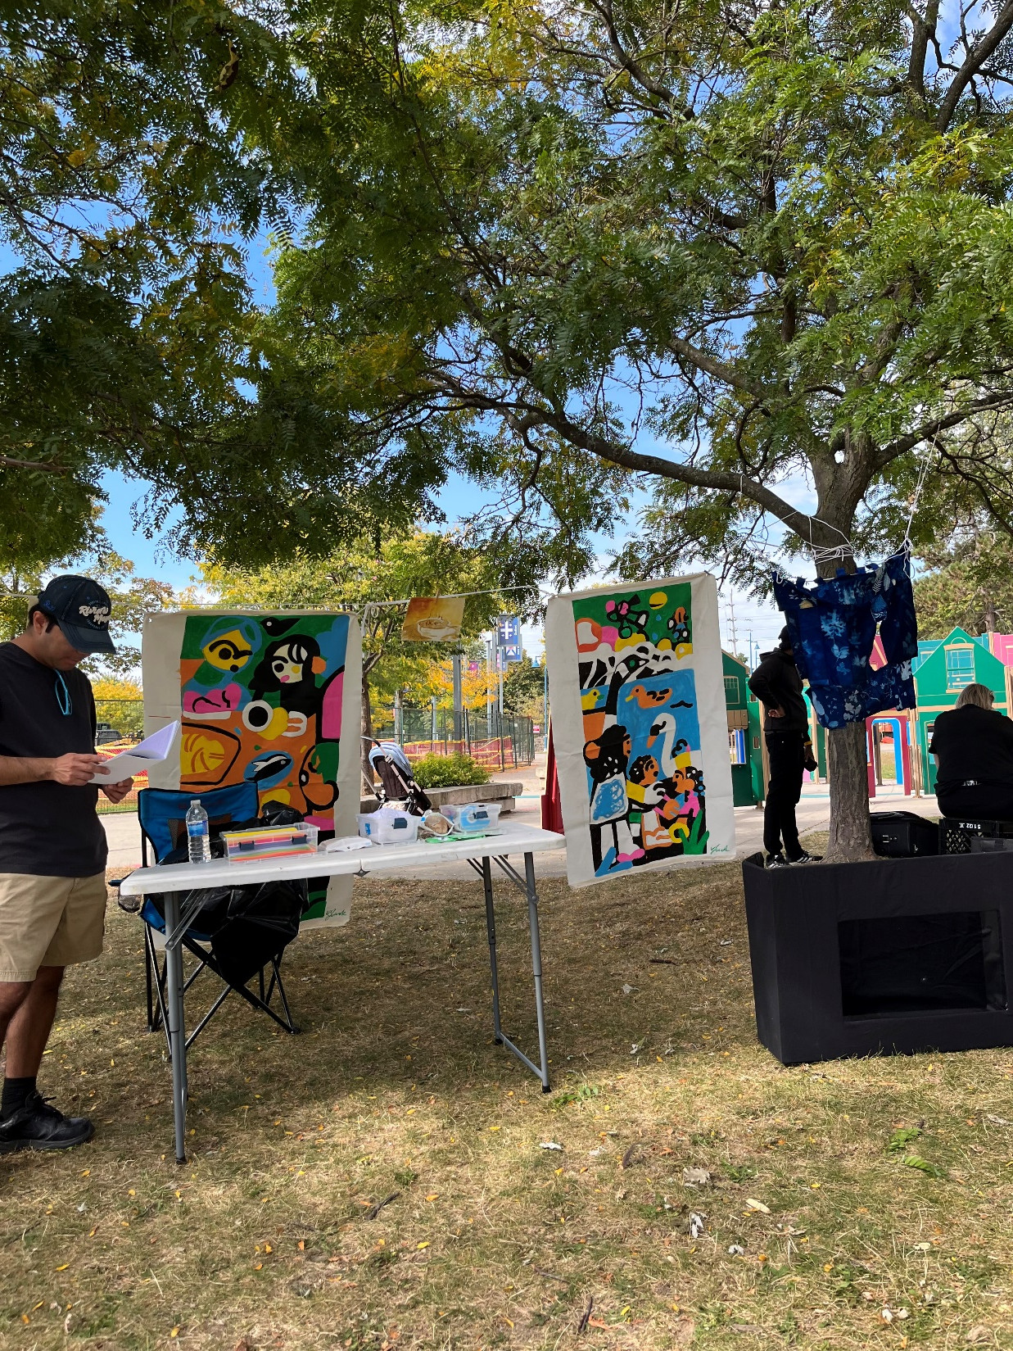
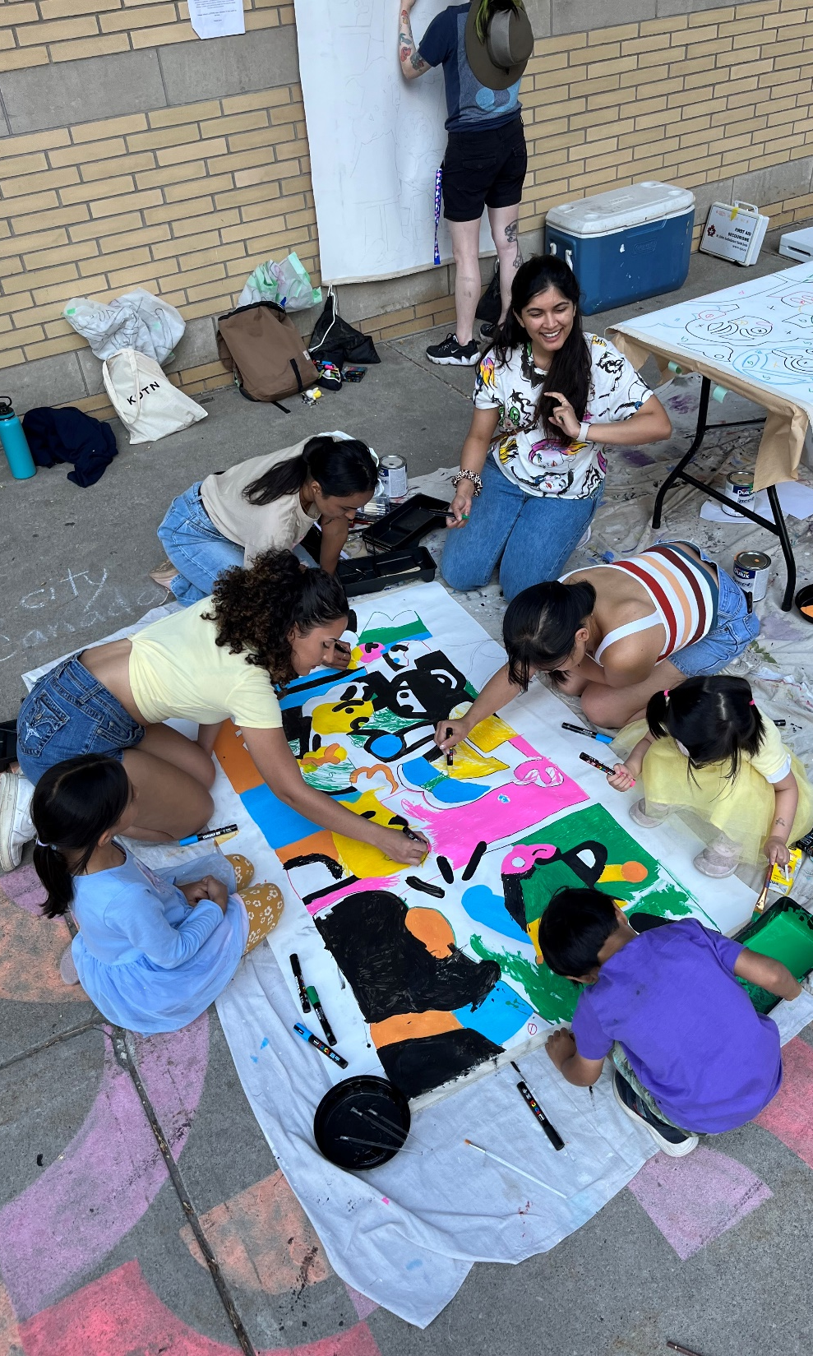
Reducing Redtape
Mo(ve)ment
STEPS, Mo(ve)ment Series, 2023. Various locations in Port Credit, Downtown Core, Cooksville.
Notes:
(Z)
Movement
Series of art-based workshops, live performance and free community events to encourage community gathering, creative expression
In Port Credit, Cooksville & DT Core
Built into the Scope of Work for the projects – Bidder must purchase goods and services from local businesses where possible

Slide 38
Reducing Red tape
Improved communication with BIAs
Helping to streamline approval processes
Identifying barriers and ways to remove them
Annual walk-abouts
Notes:
(M)
Reducing Red Tape
To help reduce red tape for the BIAs and ensure strong collaboration going forward, the City is always working towards having improved communication pathways with the BIAs – we meet with them every year, more regularly on projects if needed,
Our City Liaison hosts a walkabout in each BIA where we get to walk around, identify issues and opportunities – many solutions and projects have come out of this
We look for barriers they may be facing and ways to remove them – this is where the reference guide really helps in clarifying who is responsible for what

Slide 39
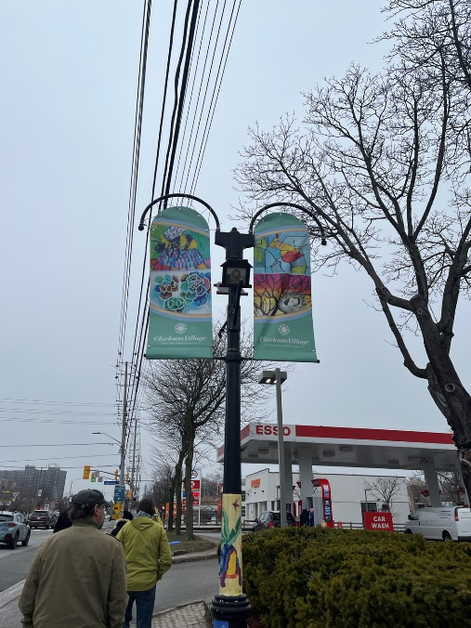
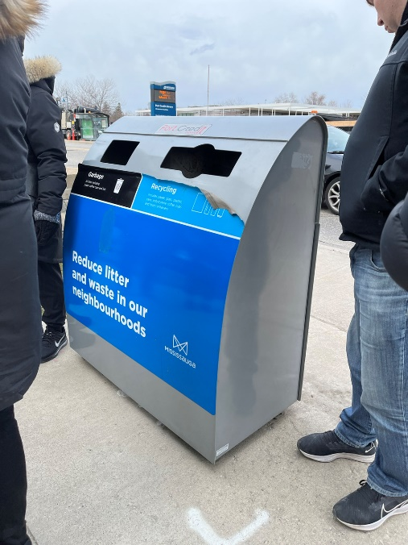
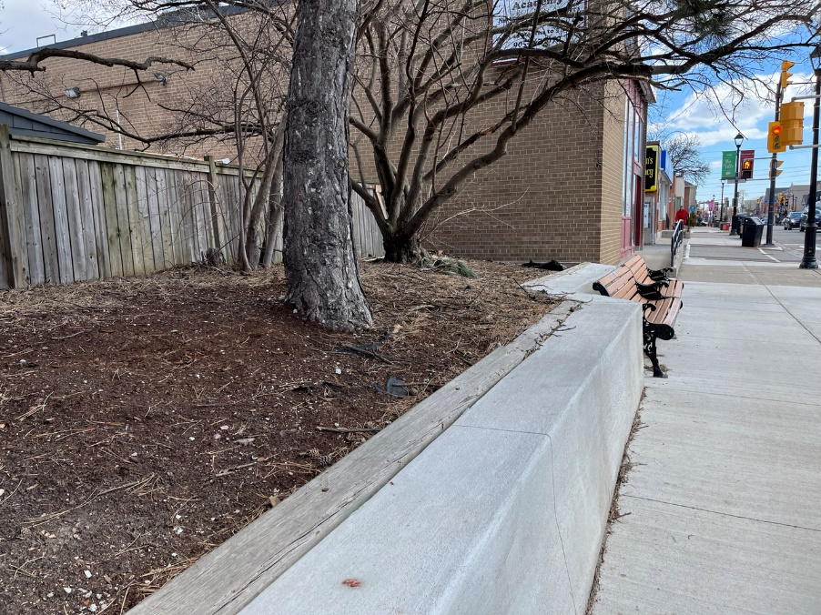
Annual BIA Walk-abouts
Annual walkabouts with BIA staff, and City staff involved in maintenance, boulevards
Notes:
(M)
As we eluded to earlier a really effective tool we use is to host annual BIA walkabouts with BIA staff, and City staff that are involved in maintenance, such as the boulevards, street lighting, park operations
We also attend to identify any cultural opportunities – a handful of opportunities have arisen from these walkabouts – ways to beautify, animate and create a welcoming environment

Slide 40
Tackling challenges of working on private property
My Main Street Grant - Cooksville Mural Festival
Not successful in getting funding
This highlighted the need for a mural on private property grant
Potential for temporary uses in vacant commercial properties
Meanwhile uses in London, UK
Notes:
(M) (Z to speak to Meanwhile uses)
Tacking challenges of working on private property
As a municipality, we are limited in what we can fund and BIAs are limited in what they can fund
We see there are many opportunities in the public realm but where technically it is private property (we want to clarify we’re really talking about those spaces that are easily accessible or easy to view for the public, but technically are private property – we’re not talking about doing projects in people’s backyard or in enclosed/restricted access spaces)
We feel a case can be made to activate or animate these spaces, however technically we cannot fund projects on private property
Another example is storefront windows – to animate them with temporary public art and other activations – this could also be a way bring vibrancy to a main street or BIA that lacks public space that can be programmed or activated
(Z) In London, UK this is part of a big movement called “Meanwhile Uses” where the City has introduced supportive zoning measures to enable temporary use of vacant commercial lands – a great way to open up space in a city where space is expensive and very limited
This is largely targeted at vacant commercial properties on main streets or empty plots of land awaiting redevelopment – it also gives the owner the opportunity to try out a variety of tenants while limiting long term risks
London’s planning and permitting process provides flexibility – certain classes of uses allow change of use on a temporary basis for up to three years
We had applied for a My Main Street Grant to do a Cooksville Mural Festival that would involve a series of private property walls that we could enter into an agreement on - and fund through the grant. However we were unsuccessful in getting the grant
For us, this highlighted the need for a private property mural grant program – something we are hoping to explore in the short term
-could talk about mural festival – not successful in getting funding – highlight the need for a mural private property grant

Slide 41
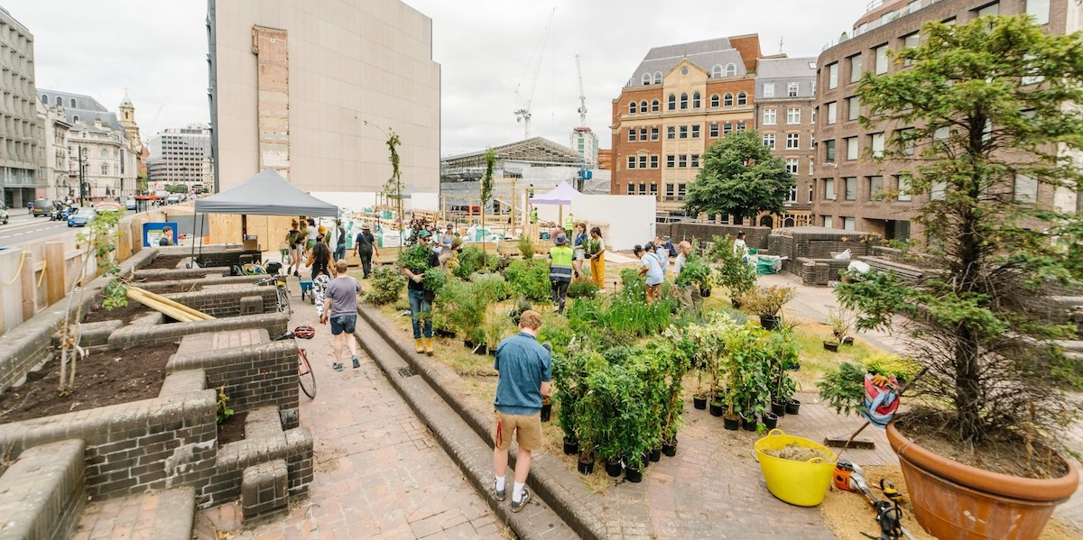
Meanwhile Uses, London UK
Notes:
(Z to speak to Meanwhile uses)
(Z) In London, UK this is part of a big movement called “Meanwhile Uses” where the City has introduced supportive zoning measures to enable temporary use of vacant commercial lands – a great way to open up space in a city where space is expensive and very limited
This is largely targeted at vacant commercial properties on main streets or empty plots of land awaiting redevelopment – it also gives the owner the opportunity to try out a variety of tenants while limiting long term risks
London’s planning and permitting process provides flexibility – certain classes of uses allow change of use on a temporary basis for up to three years
We had applied for a My Main Street Grant to do a Cooksville Mural Festival that would involve a series of private property walls that we could enter into an agreement on - and fund through the grant. However we were unsuccessful in getting the grant
For us, this highlighted the need for a private property mural grant program – something we are hoping to explore in the short term
-could talk about mural festival – not successful in getting funding – highlight the need for a mural private property grant

Slide 42
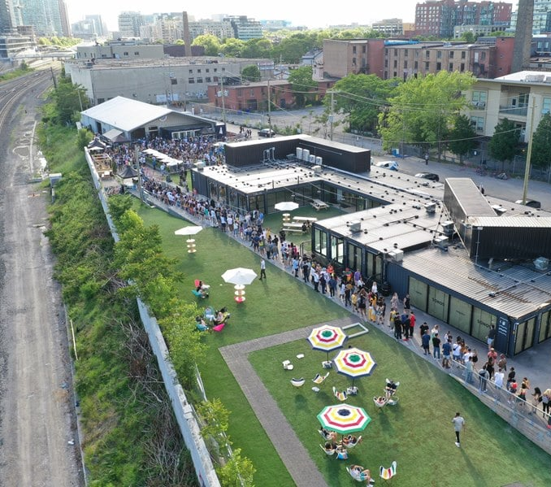
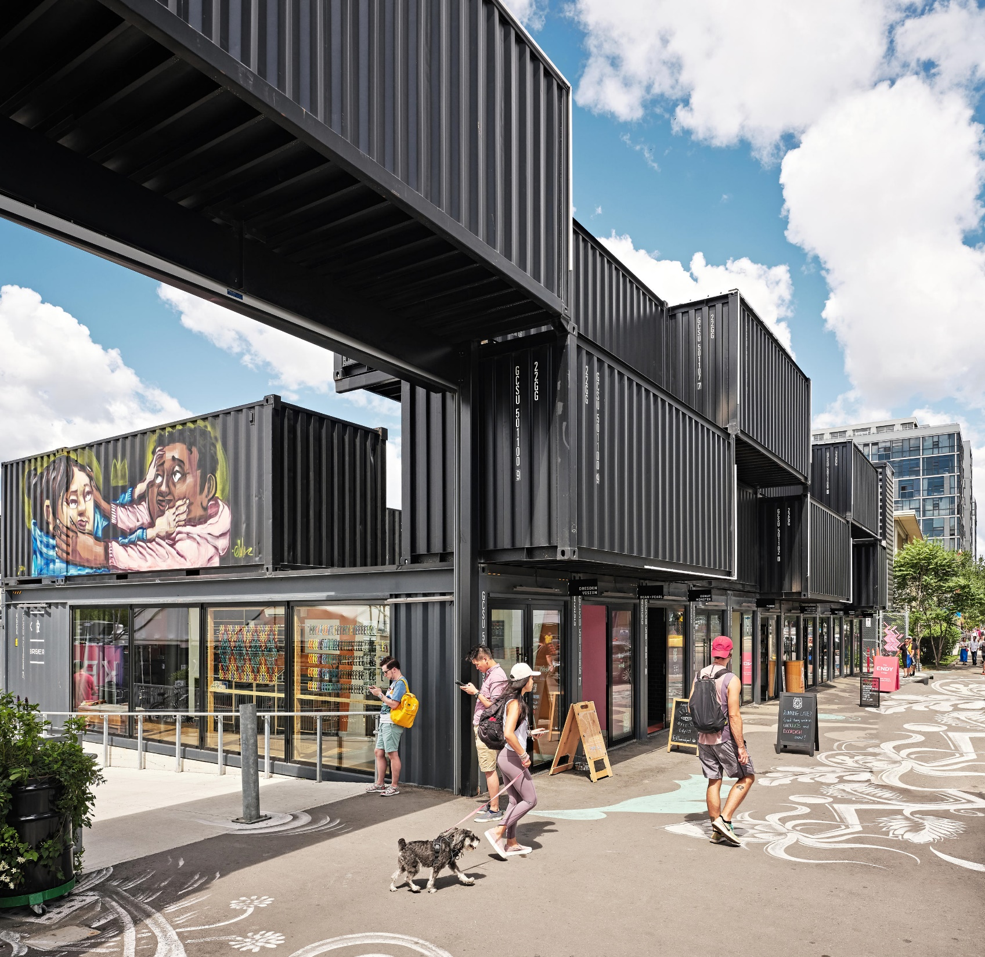
Stackt Market, Toronto
Notes:
(M) Meanwhile uses – Stackt Market, Toronto
Temporary container market on vacant City lands
Photo credit: Eventsource.ca (left) and right: Industryous Photography (architonic.com) https://www.architonic.com/en/project/lga-architectural-partners-stackt-market/20120432

Slide 43
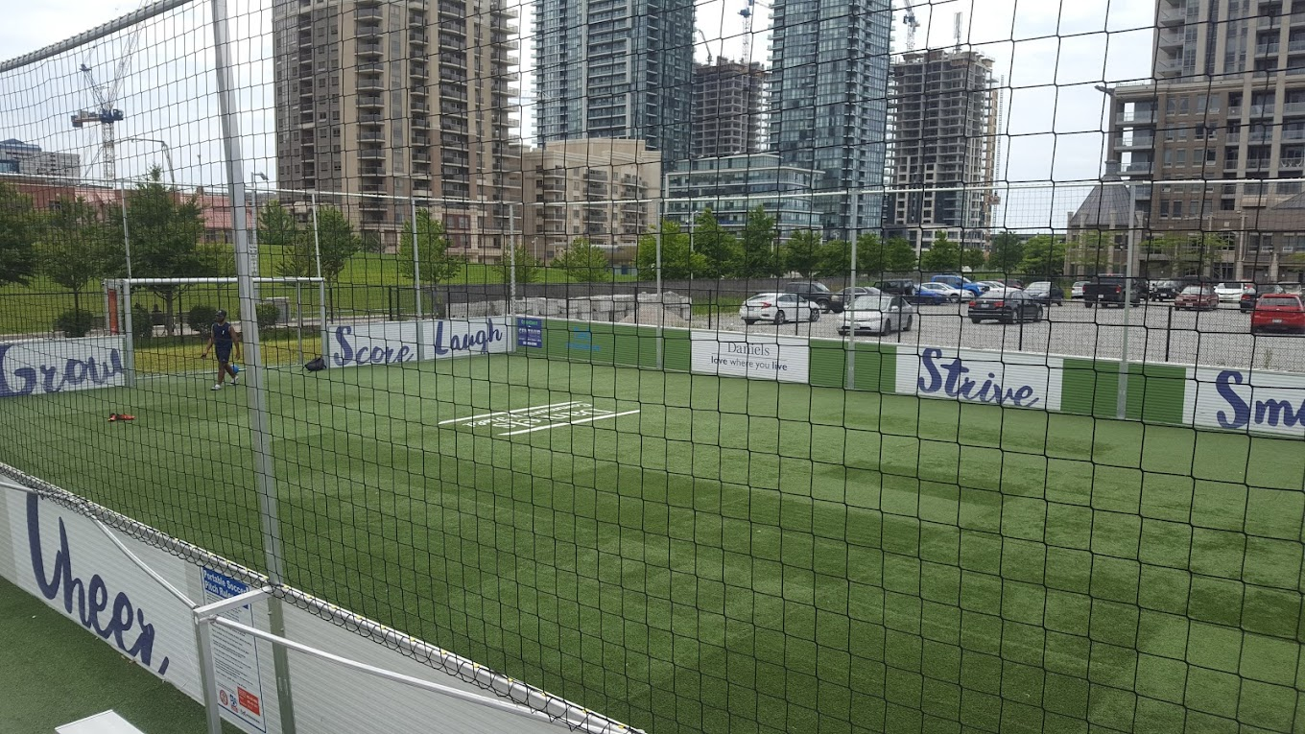
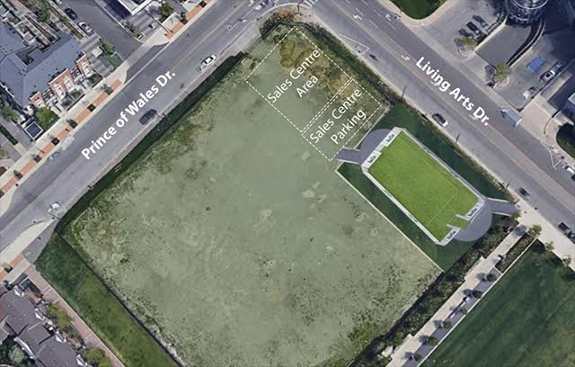
Daniels Boxed Soccer Field, Mississauga
Notes:
(M) Meanwhile uses – Daniels Community Field – Boxed Soccer Field in Downtown Mississauga
Collaboration with Parks & Daniels – pilot project followed by a 9 year sponsorship agreement
First of its kind in all of Canada
Allows the city to provide outdoor space for play in the area where parkland is limited and density is high
This land isn’t going to be developed in the interim
City is responsible ofr installation, maintenance and repair of the soccer pitch. Daniels is responsible for initial costs of the pitch, land prep, landscaping, lighting and seating
Photo credit: Obaid Rashidi

Slide 44
Q&A
Has your BIA come across challenges with funding projects on private property and how have you navigated that?
Notes:
(Z)
We’d like to hear from you on this – has your BIA come across challenges with funding projects on private property and how have you navigated that?

Slide 45
Funding
City grant opportunities – Cultural Festivals & Celebrations Event Grant, Culture Project Grants
Leveraging funds that the BIA can apply for (i.e. STEPS I Heart Main street).
Exploring opportunities to establish a private mural grant program
Notes:
(Z)
Funding
Highlight the City grant opportunities available to BIAs – Cultural Festivals & Celebrations Event Grant, Culture Project Grants
Identifying opportunities to leverage grants – conversations around a façade improvement program that would help
Looking to the future – how we want to go about continuing to support Cultural Districts

Slide 46
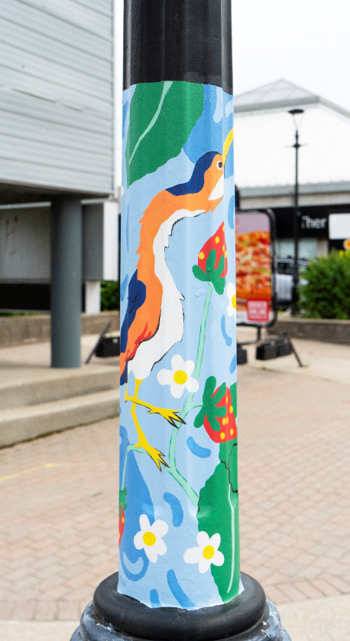
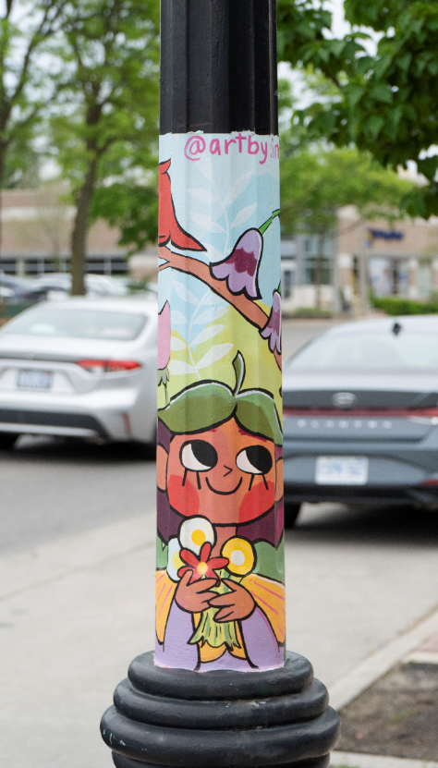
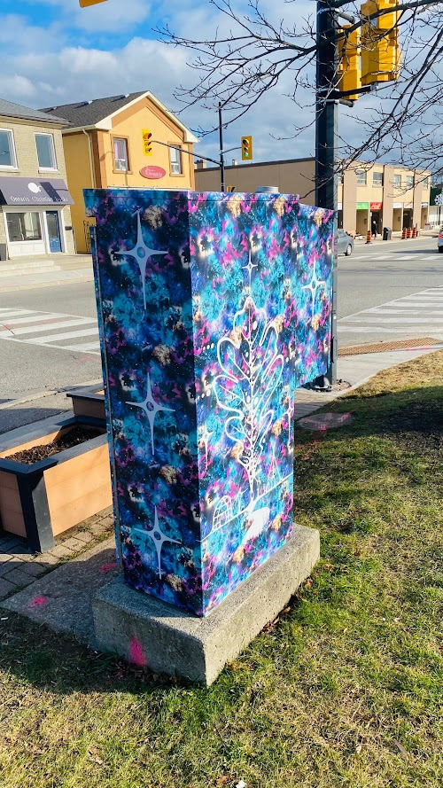
STEPS - I HeART Main Street Initiative
Sima Naseem, Yen Linh Thai, Clarkson Banner Post Murals, 2022. Clarkson. STEPS Public Art.
Nyle Miigizi Johnston, Odenanging Mtigmishing -Village of the Oaks, 2023. Streetsville, STEPS Public Art.
Notes:
(Z)
STEPS – I Heart Main Street Initiative
Many of you may be familiar with the I Heart Main Street initiative by STEPS Public Art
They award grants to BIAs for small scale public art projects, which helps the BIAs build capacity
Their program is supported for the Ontario Trillium Fund
Because STEPS has been on our roster, and we’ve been in close communication with the BIAs – we’ve been able to hire STEPS to do additional work for these projects – and provide additional funds through our placemaking budget
For example, with the Clarkson banner posts – we helped the BIA include 10 banner posts instead of the original 5
In Streetsville, we helped fund a traffic signal box wrap (both pictured above)

Slide 47


STEPS - I HeART Main Street Initiative
Julia Prajza, Streetsville Retaining Wall Mural, 2023. Streetsville, STEPS Public Art.
Notes:
(Z)
STEPS – I Heart Main Street Initiative
Here is another example of a retaining wall that was completed last summer in Streetsville – this opportunity was also identified through the annual walkabout, so it was on our radar as an opportunity

Slide 48
Q&A
Has your municipality or BIA made strategic efforts to establish an arts or cultural district? If so, what kinds of tools did you employ to support this?
What are some ways that your BIA and municipality coordinate efforts?
How can municipalities better support BIAs with placemaking initiatives?
Notes:
So that brings us to the end of our presentation, we can open up the floor to questions – we’ve also included a list of questions to get the conversation started

Slide 49
Q&A
What successes have you had in implementing placemaking projects?
What are some barriers you have come across with implementing placemaking or temporary public art activations?
Notes:
So that brings us to the end of our presentation, we can open up the floor to questions – we’ve also included a list of questions to get the conversation started
Are there any additional questions?

Slide 50



Q&A
Thank you!
Michael Tunney
Manager, Culture Planning and Public Art
City of Mississauga
Michael.tunney@Mississauga.ca
Cultural Districts
Mississauga.ca/cultural-districts
Public Art
Mississauga.ca/publicart
Culture Planning
Culture.planning@Mississauga.ca
Zainab Abbasi
Planner, Culture Planning
City of Mississauga
Zainab.abbasi@Mississauga.ca
Notes:
Thank you for having us, we hope this presentation sparked some ideas for you, or you were able to relate to some of the challenges and topics we talked about today.
We’ve included our contact info on the slide above if you’d like to get in touch with us
Photo credits: Finding Home, Mango Peeler

